Slide 1
Michèle Shuster • Janet Vigna • Gunjan Sinha • Matthew Tontonoz
Biology for a
Changing World
SECOND EDITION
Lecture PowerPoint
CHAPTER 25
Overview of Physiology
Copyright © 2014 by W. H. Freeman and Company

Slide 2
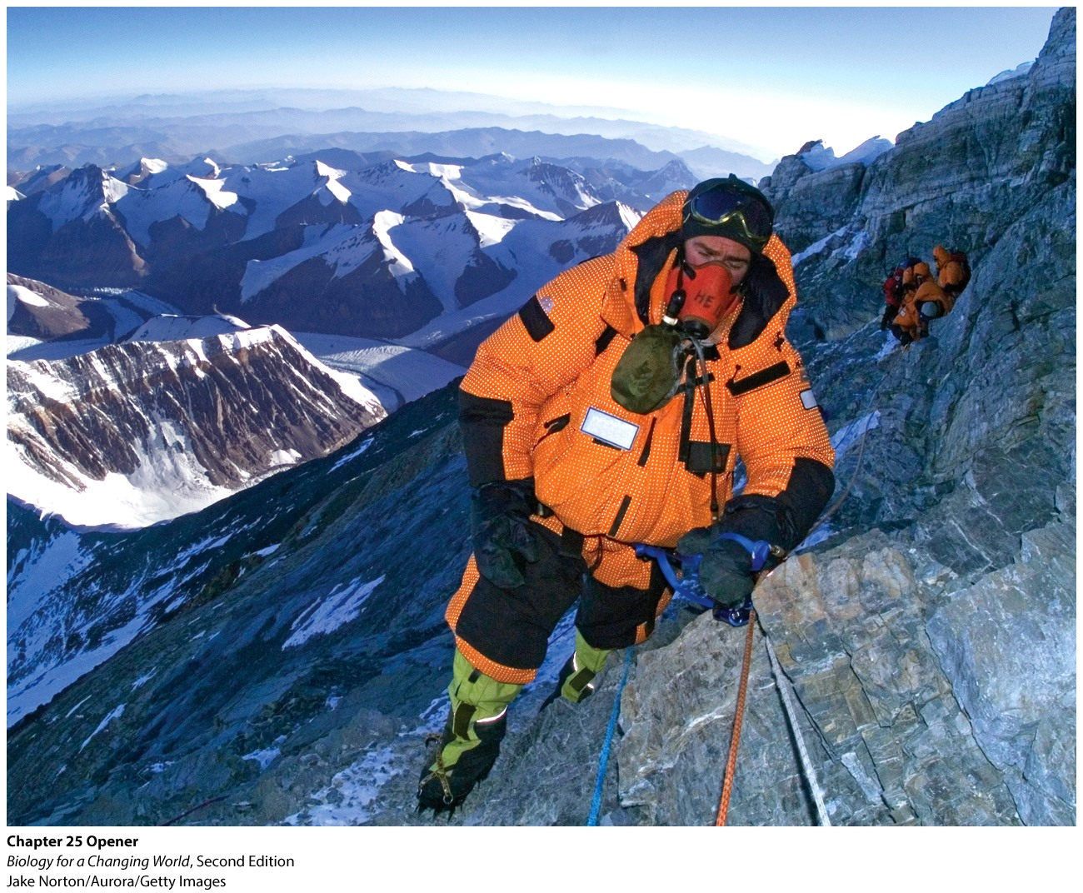
Chapter 25
Overview of Physiology

Slide 3
Driving Questions
1. How are the bodies of living organisms organized?
2. How do humans and other organisms regulate body temperature?
3. What physiological systems are regulated by homeostatic feedback loops?

Slide 4
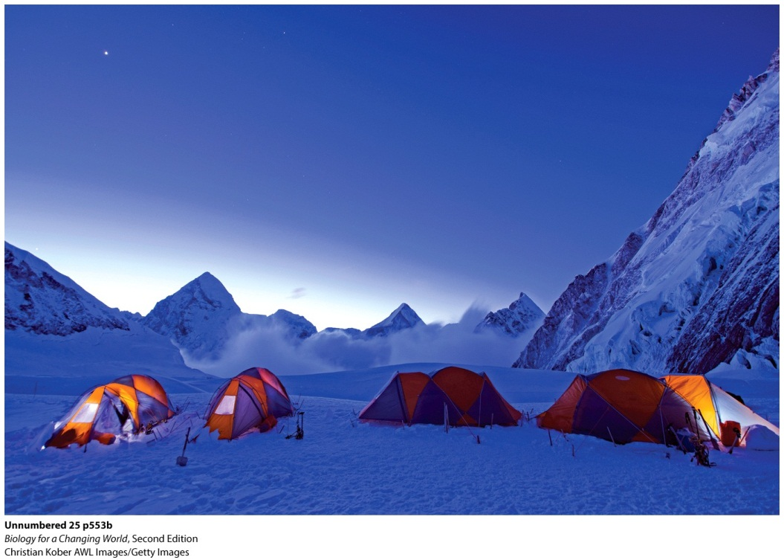
Man versus mountain
Mount Everest
29,035 feet above sea level
Temperatures average −53Cº
Extreme challenge for human body
Notes:
Ten people died on Mount Everest in 2012.

Slide 5
The human body
Made up of many parts working together in a coordinated fashion
Organized hierarchically
Smaller components are organized into increasingly larger units
Anatomy: study of physical structures that make up an organism

Slide 6
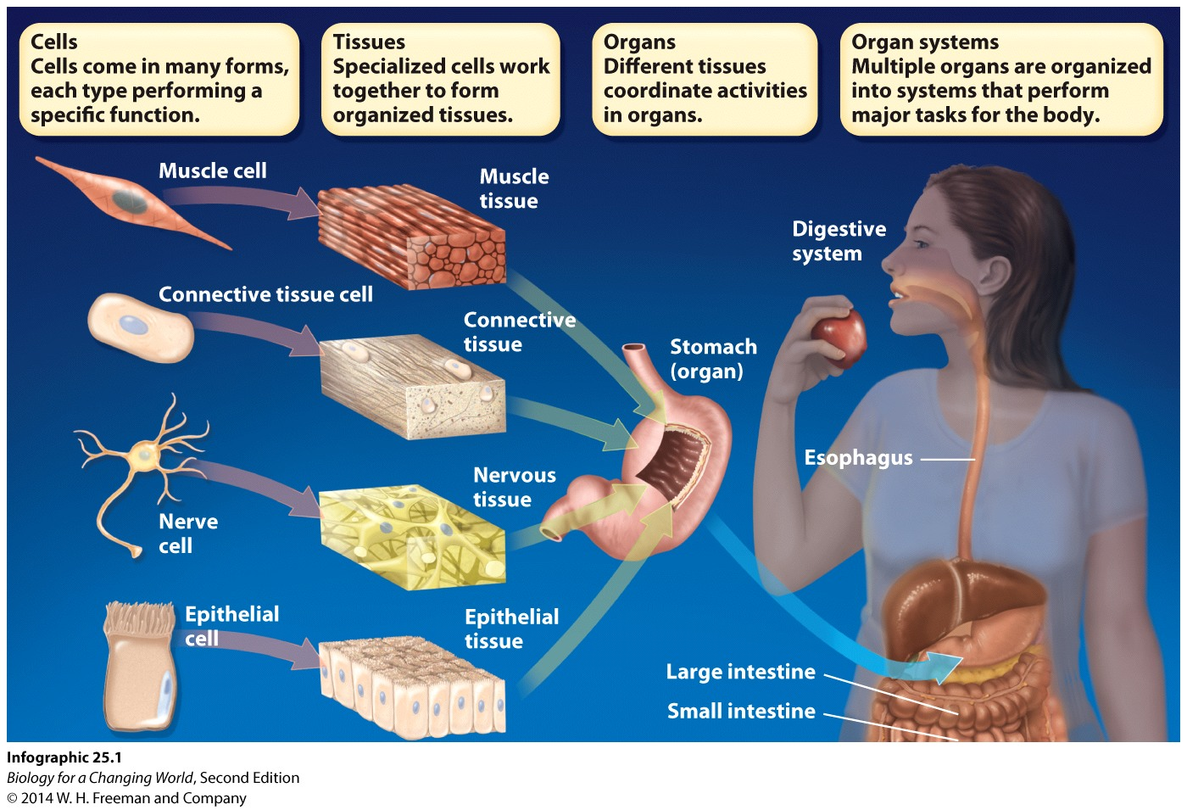
The human body

Slide 7
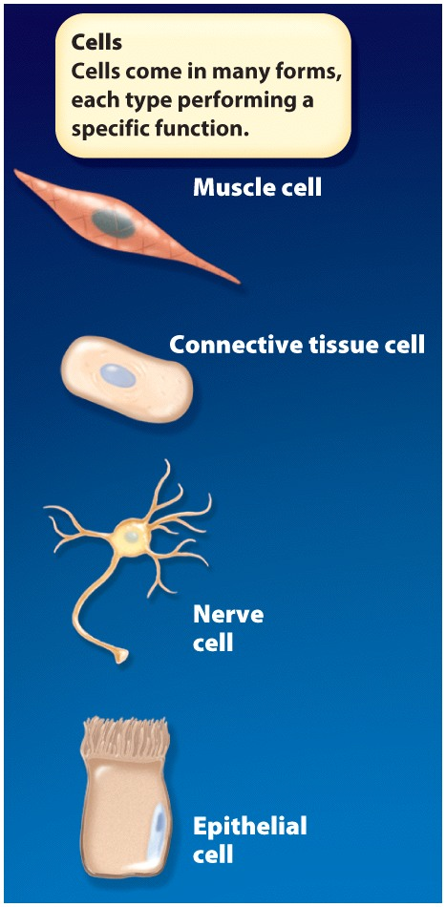
How is the human body organized?
Smallest anatomical unit is the cell
Each cell classified as one of a few hundred different types
Notes:
Human bodies have an anatomical structure that is well adapted to living in certain environments and performing certain functions.
Our species evolved in the hot, flat savannahs of Africa where environmental conditions favored big brains, opposable thumbs, and bipedal posture.

Slide 8
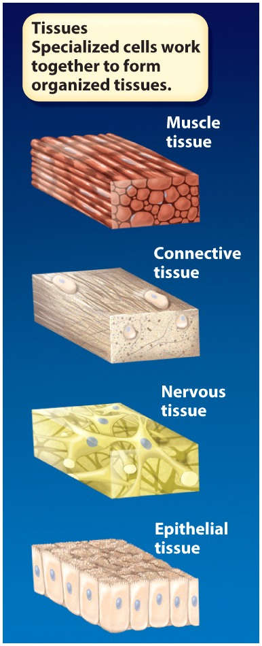
How is the human body organized?
Cells organized into tissues
integrated groups of specialized cells
Animals have four kinds of specialized tissue
epithelial, connective, muscle, and nervous
Notes:
Tissue: an organized collection of a single cell type working to carry out a specific function

Slide 9
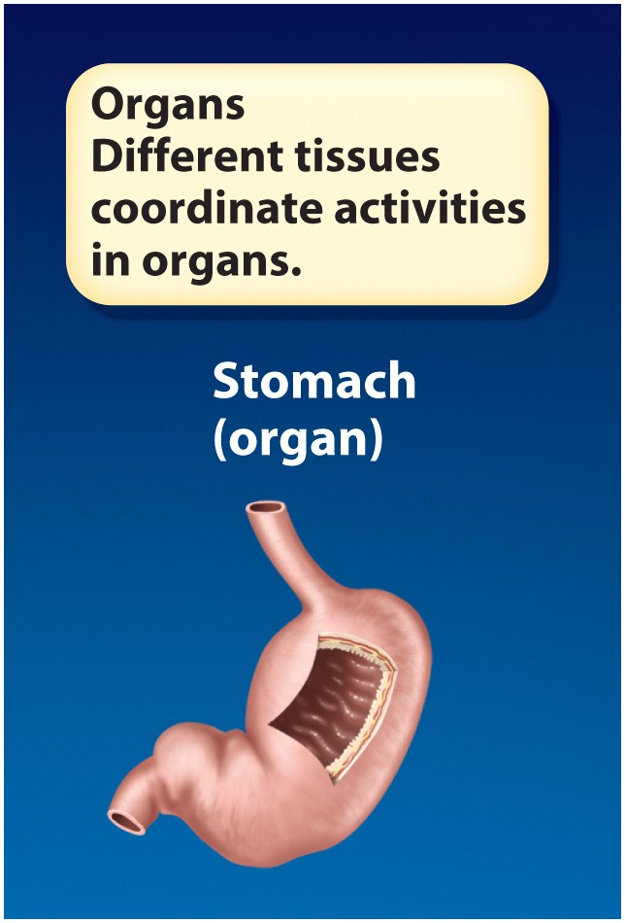
How is the human body organized?
Organ
structure made up of different tissue types working together to carry out a common function

Slide 10
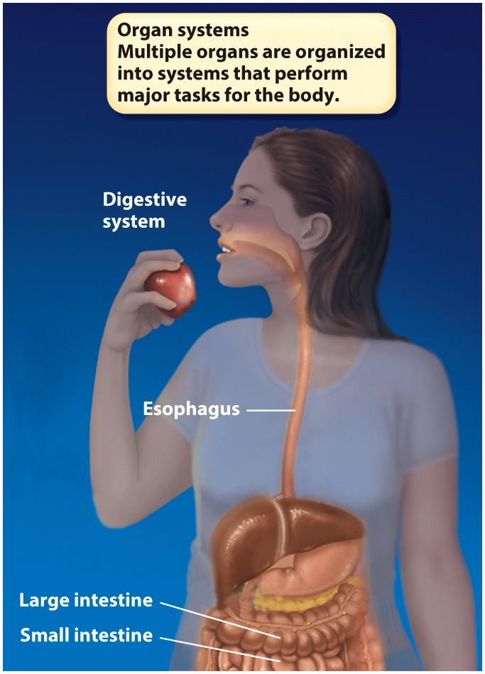
How is the human body organized?
Organs interact chemically and physically as part of organ systems
Highest level of organization
Notes:
The stomach works with the esophagus, small intestine, and liver to digest and absorb food as part of the digestive system.

Slide 11
Physiology
The study of the way a living organism’s physical parts function
Homeostasis
maintenance of a relatively stable internal environment even when the external environment changes

Slide 12
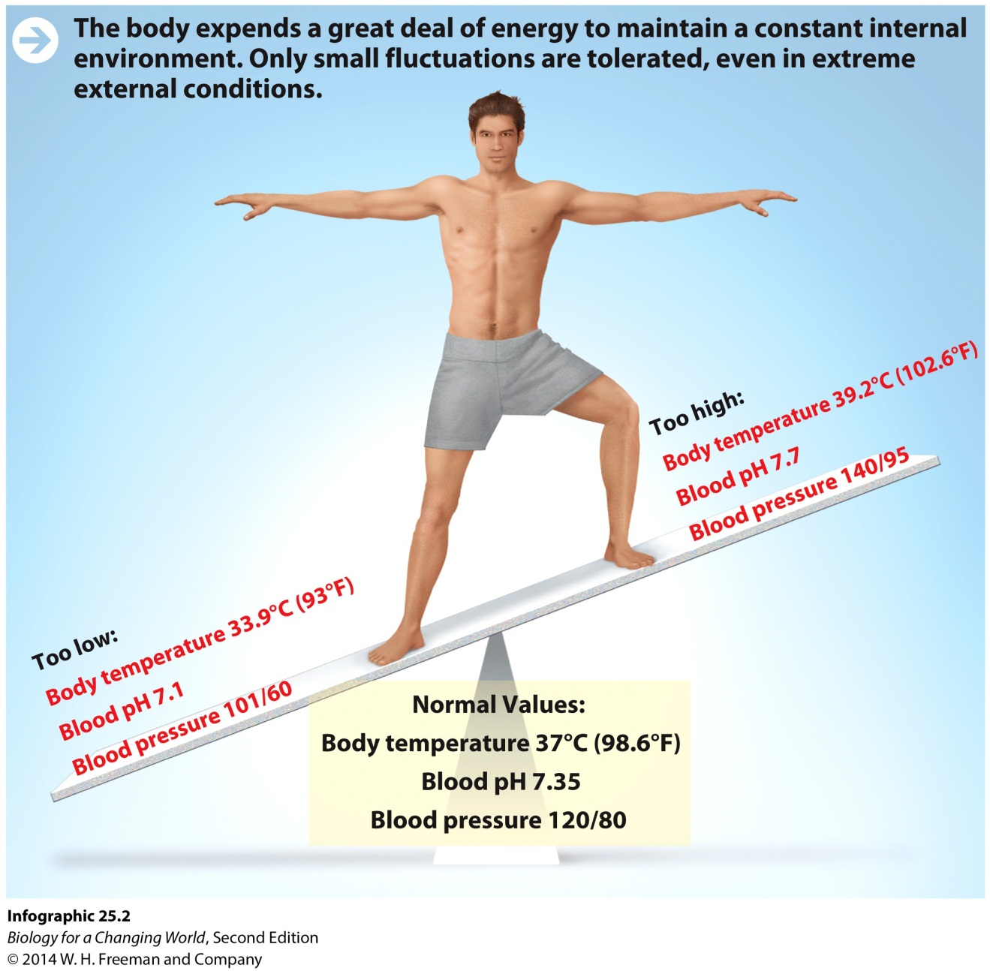
Homeostasis

Slide 13
Homeostasis: thermoregulation
Humans have optimal operating temperatures
Enzymes function only within a very narrow temperature range
Thermoregulation
Maintenance of a relatively stable internal body temperature
Notes:
Our body temperature is kept at a consistent 37°C (98.6°F). This is just one example of how the body tries to maintain homeostasis.

Slide 14
Homeostasis: thermoregulation
Peripheral vasoconstriction
reduction in diameter of blood vessels just below skin surface
pushes blood to the body core
decreases amount of heat loss
Peripheral vasodilation
expansion of the diameter of blood vessels
increases blood flow to the skin
increases heat
Notes:
Human bodies respond to cold in two main ways: by conserving the heat they already have and by generating more. To conserve heat, two main physiological responses help prevent overheating: peripheral vasodilation and evaporative cooling, or sweating, which cools the body by releasing heat to the air.

Slide 15
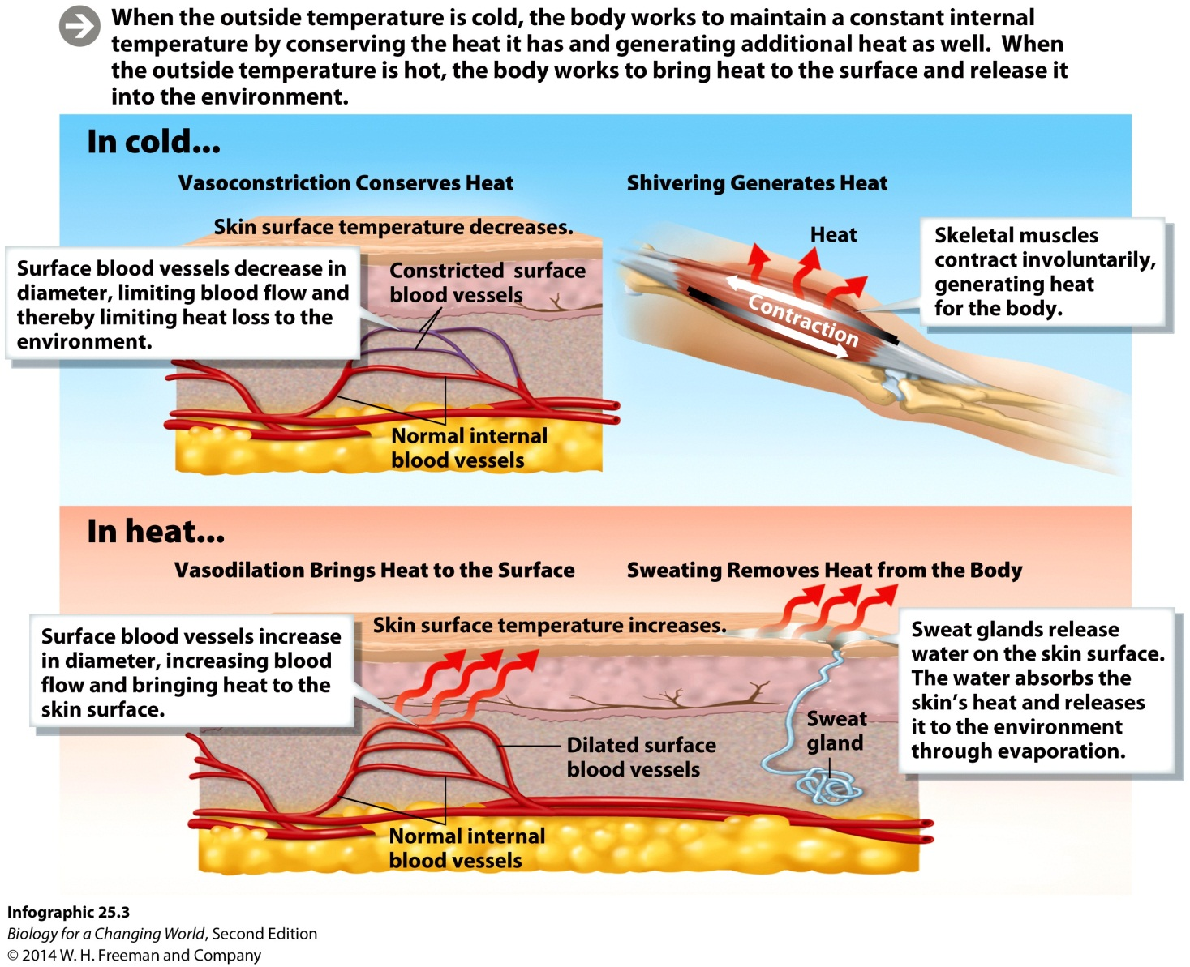
Homeostasis: thermoregulation

Slide 16
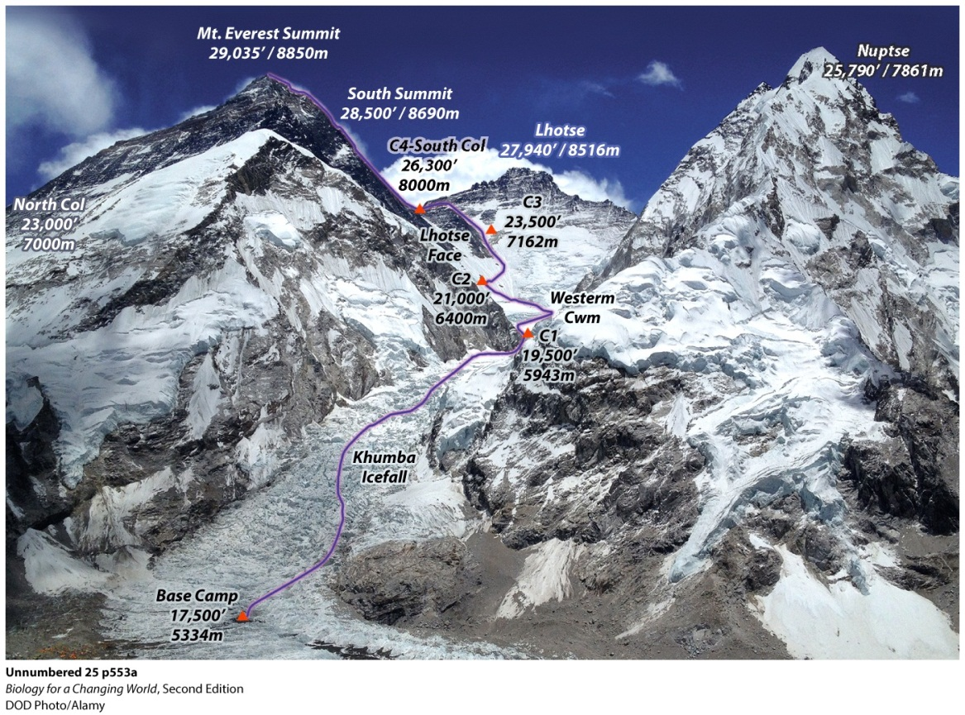
Homeostasis
Acclimatization
Physiologically adjusting to environmental change over time
Reversible
Helps to avoid hypoxia
low level of oxygen in blood
Notes:
To help cope with conditions of low oxygen, climbers spend about 6 weeks acclimatizing their bodies to the conditions, spending a few nights at progressively higher elevations. Their bodies respond by increasing the production of red blood cells, the cells that contain hemoglobin and carry oxygen.

Slide 17
Homeostasis: thermoregulation
Hypothalamus
The body’s thermostat
Structure at base of brain
Receives signals from sensors
specialized cells that detect specific sensory input (e.g., temperature, pressure)
Sends information to effectors
cells, tissues, or organs that respond
Notes:
Hypothalamus: the master coordinator of the brain, responsible for a variety of physiological functions. For example, it can send a signal to blood vessels in the skin, causing them to constrict in peripheral vasoconstriction. It can also send a signal to muscles to start shivering. The hypothalamus does more than regulate body temperature―it regulates hunger, thirst, sexual arousal, and sleep.
Effector: a cell or tissue that acts to exert a response on the basis of information relayed from a sensor

Slide 18
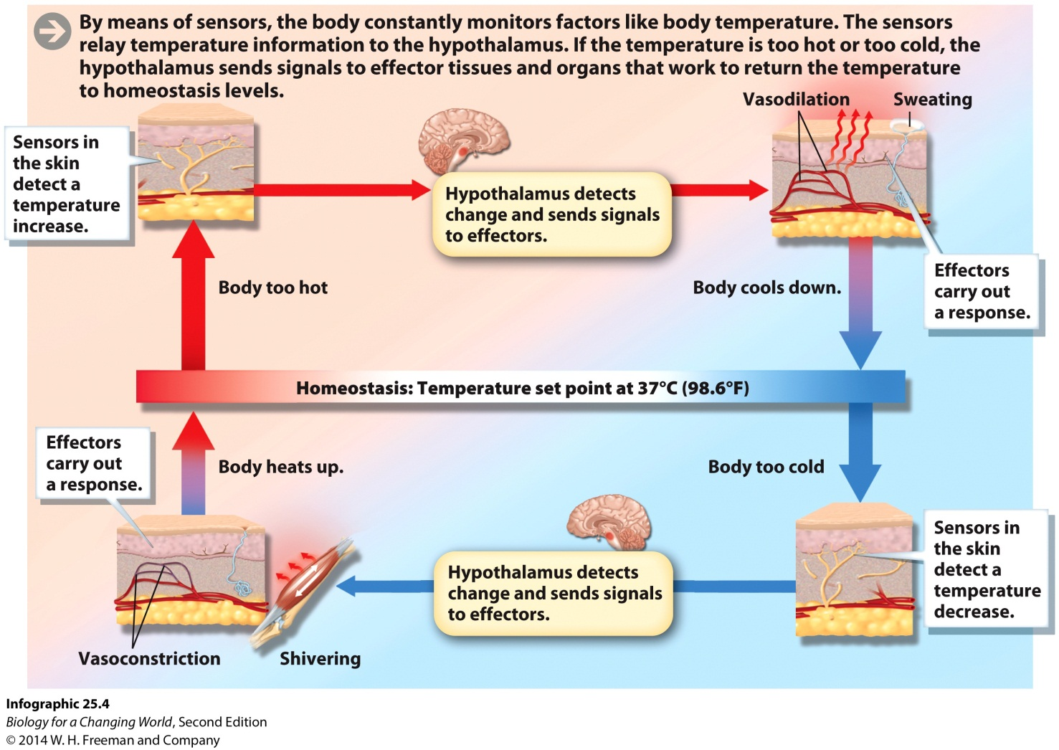
Homeostasis
Feedback loop
Circuit of sensing, processing, and responding
Notes:
Feedback loop: a pathway that involves input from a sensor, a response via an effector, and detection of the response by the sensor

Slide 19
Homeostasis: feedback loops
Negative feedback loop
Output of the loop feeds back on the sensors
to decrease the response
Positive feedback loop
Output of a system acts to increase the
response of the system

Slide 20
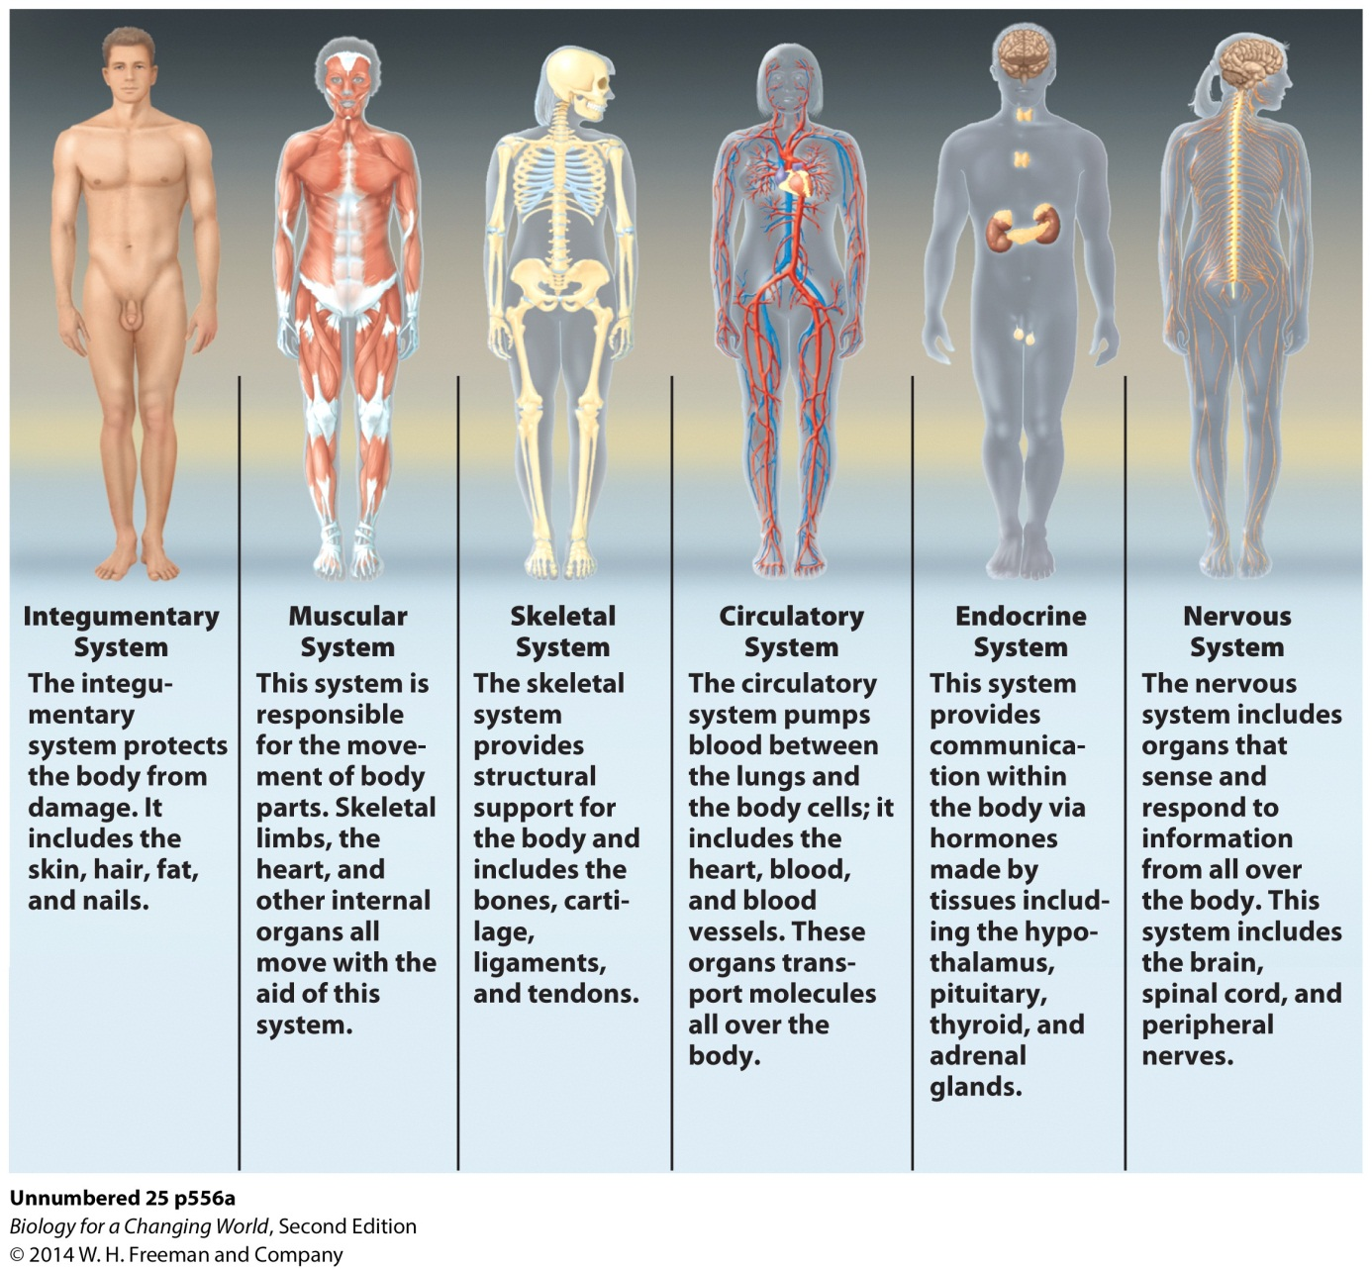
Organ systems

Slide 21
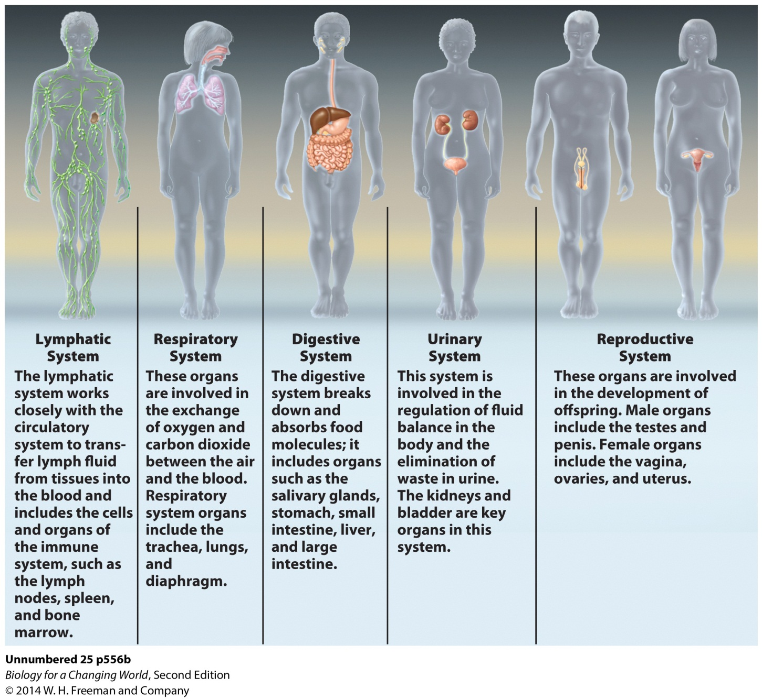
Organ systems

Slide 22
Homeostasis: hypothalmus
Hypothalamus works closely with
nervous system: organs that sense and respond to information
endocrine system: collection of glands that secrete hormones (chemical signaling molecule)
connects to the endocrine system via the pituitary gland
Notes:
Pituitary gland: an endocrine gland in the brain that secretes many important hormones

Slide 23
Homeostasis: thermoregulation
Requires energy
Main fuel is glucose
If not used immediately, stored as glycogen
Glucose levels regulated by pancreas
secretes the hormones insulin (decreases blood sugar) and glucagon (increases blood sugar) and digestive enzymes
Notes:
Glycogen: an energy-storing carbohydrate found in liver and muscle
Insulin binds to receptors on muscle and liver cells, signaling them to remove sugar from the blood. Insulin also signals these cells to make glycogen, using the sugars taken up from the blood.
Glucagon triggers muscle and liver cells to convert their stored glycogen to glucose.

Slide 24
Homeostasis: blood-glucose

Slide 25
Homeostasis: water balance
Osmolarity
Concentration of dissolved solutes in the blood
For example, electrolytes
Osmoregulation
Maintenance of relatively stable volume, pressure, and solute concentration of bodily fluids, especially blood
Notes:
Dehydration is a little-known cold-weather risk. In cold conditions, our bodies must work harder under the extra weight of heavy clothing, and sweat evaporates quickly in cold, dry air. We also lose a significant amount of water as water vapor when we exhale.

Slide 26
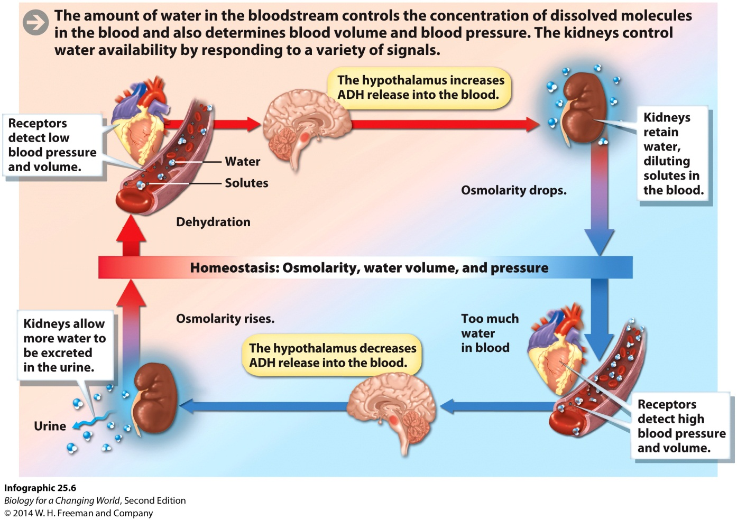
Homeostasis: water balance
Hypothalmus works with the kidney
Organ involved in osmoregulation, filtration of blood
Notes:
When you are dehydrated (when you have less fluid in your blood) the concentration of dissolved solutes is higher. If the hypothalamus registers that the concentration of solutes in the blood is high, it will trigger a sense of thirst, encouraging you to drink. At the same time, it triggers the release of antidiuretic hormone from the pituitary, which travels through the bloodstream and acts on the kidneys.

Slide 27
How do other organisms thermoregulate?
Endotherm: animal that can generate body heat internally to maintain its body temperature

Slide 28
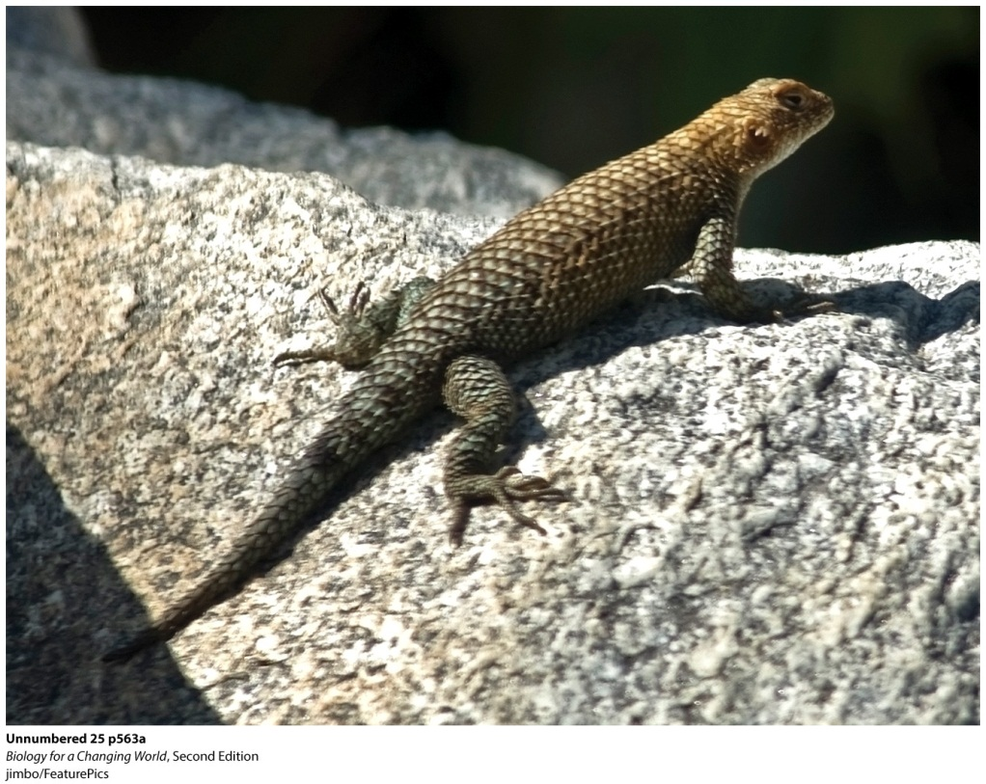
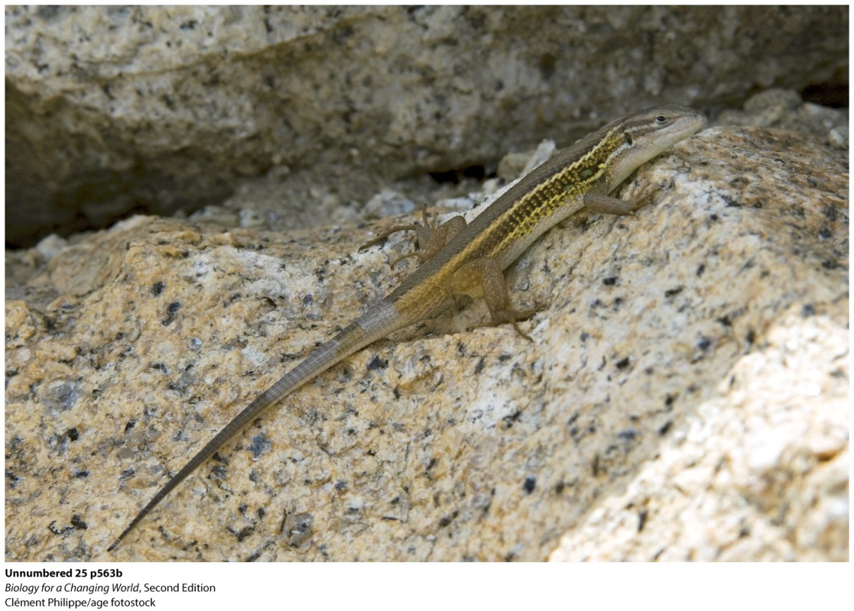
How do other organisms thermoregulate?
Ectotherm: animal that relies on environmental sources to maintain its body temperature
Notes:
Ectotherms rely on the environment to regulate their body temperatures, seeking sun or shade as necessary.

Slide 29
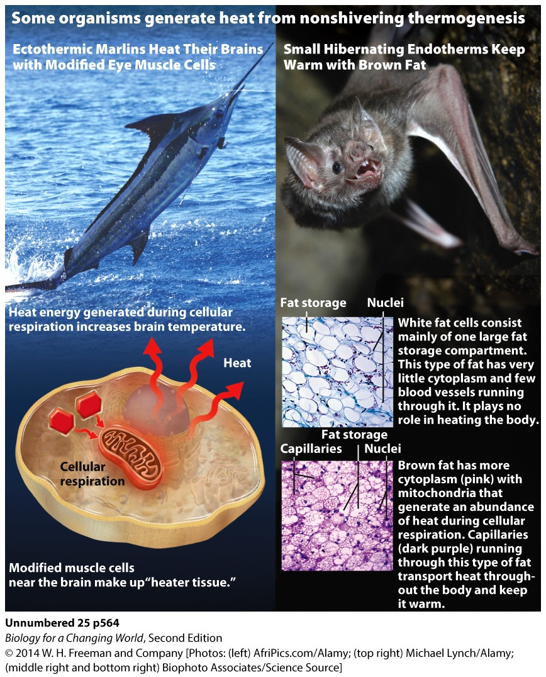
How do other organisms thermoregulate?
Nonshivering thermogenesis
Specialized tissue acts to generate heat
Brown fat converts energy to heat
Notes:
Specialized “heater tissue” generates heat to keep their brains warm. In this case, the heater tissue is modified eye muscle that acts to generate heat rather than force or movement.
In brown fat, specialized mitochondria convert energy to heat rather than to ATP, and the many blood vessels in brown fat deliver that heat to other parts of the body.

Slide 30
Summary
Multicellular organisms are organized hierarchically: cells, tissues, organs, organ systems.
Most organisms work to maintain homeostasis, a stable internal environment, which requires both sensors and effectors that work together as part of a circuit, or feedback loop.
Maintaining a relatively constant internal temperature is called thermoregulation.
Hormones are chemical messengers that travel through the bloodstream, bind to receptors on a target cell, and effect a change in that cell.
Osmoregulation is the control of water balance in the body.
Humans (and other mammals) are endotherms; we generate heat internally. Many other organisms, such as reptiles and fish, are ectotherms.

