Slide 1
Michèle Shuster • Janet Vigna • Gunjan Sinha • Matthew Tontonoz
Biology for a
Changing World
SECOND EDITION
Lecture PowerPoint
CHAPTER 27
Cardiovascular System
Copyright © 2014 by W. H. Freeman and Company

Slide 2
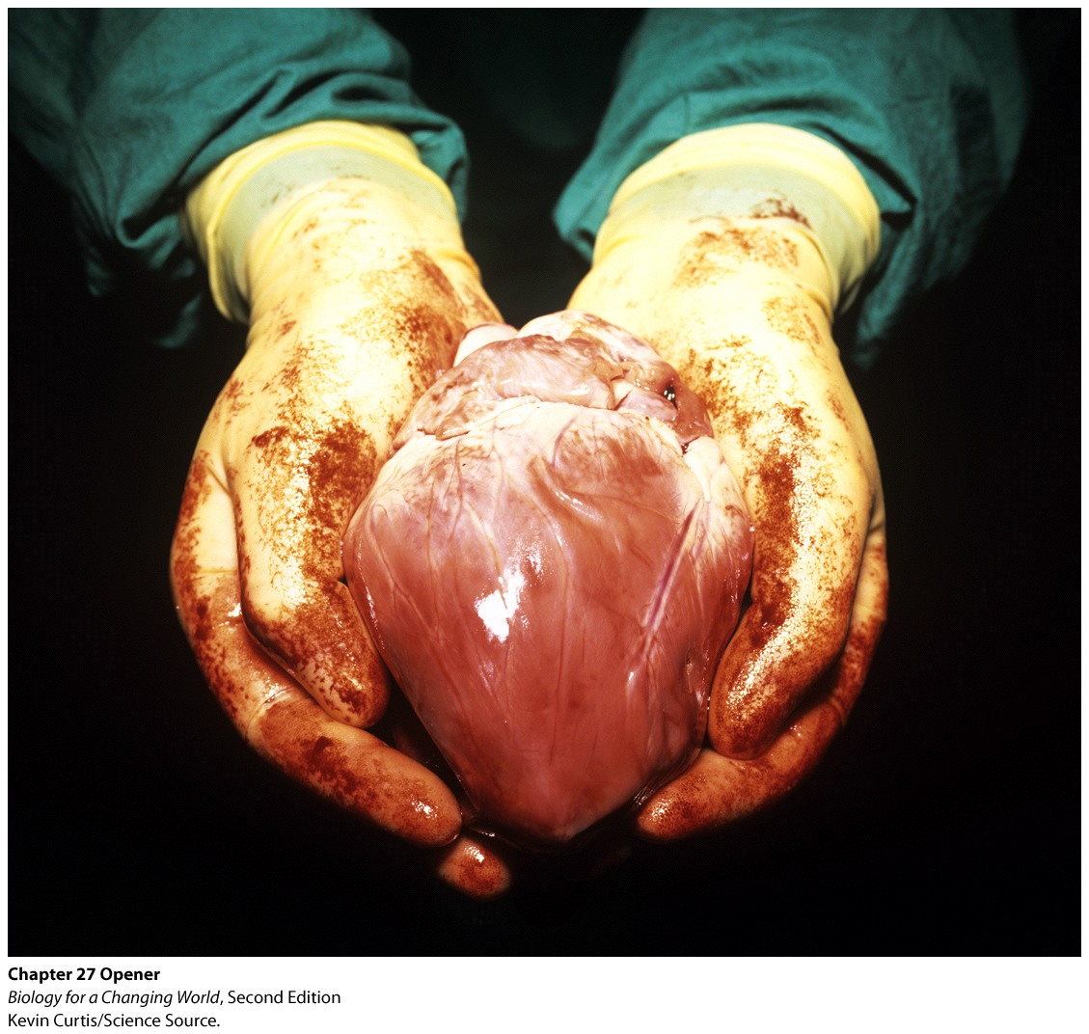
Chapter 27
Cardiovascular System

Slide 3
Driving Questions
1. What structures make up the cardiovascular system, and how
does blood flow through the system?
2. What is the structure of the heart and of the different types of
blood vessel?
3. What is the composition of blood, and what does blood do?
4. What is cardiovascular disease, and what are some of the risk
factors for developing cardiovascular disease?

Slide 4
A silent epidemic
Cardiovascular disease (CVD)
Disease of the heart or blood vessels or both
Number one killer in the United States and the developed world

Slide 5
A silent epidemic

Slide 6
The cardiovascular system
Transports nutrients, gases, hormones and other critical molecules throughout the body
Consists of the heart, blood vessels, and blood
Works closely with the respiratory system
Notes:
The respiratory system moves oxygen from the air into the lungs and removes carbon dioxide waste.

Slide 7
The cardiovascular system

Slide 8
The cardiovascular system
Heart
Muscular pump
Pumps blood throughout the body
Four chambers
two paired atria receive blood
two paired ventricles pump blood out
Notes:
Atria (singular: atrium): the chambers of the heart that receive blood. The right atrium receives low-oxygen blood from the body, and the left atrium receives high-oxygen blood from the lungs.
Ventricles: the chambers of the heart that pump blood away from the heart. The right ventricle pumps blood to the lungs, and the left ventricle pumps blood to the body.

Slide 9
The cardiovascular system
Arteries
Vessels that carry blood away from the heart
Veins
Vessels that return blood to the heart

Slide 10
The cardiovascular system
Blood
Composed of cells and liquid
Carries oxygen to all tissues of body
Carries away carbon dioxide waste

Slide 11
Cardiovascular disease
Fatty deposits develop in the arteries or heart muscle
Reduces blood flow to tissues
If coronary arteries are blocked, heart cells die
Heart attack
Notes:
Coronary arteries: the blood vessels that deliver oxygenated blood to the heart muscle
Heart attack: a restriction of blood flow to the heart, resulting in damage to the heart muscle

Slide 12
Cardiovascular function
Blood passes through the heart twice every trip through the body
Pulmonary circuit
circulation of blood between the heart and the lungs
Systemic circuit
circulation of blood between the heart and the rest of the body

Slide 13
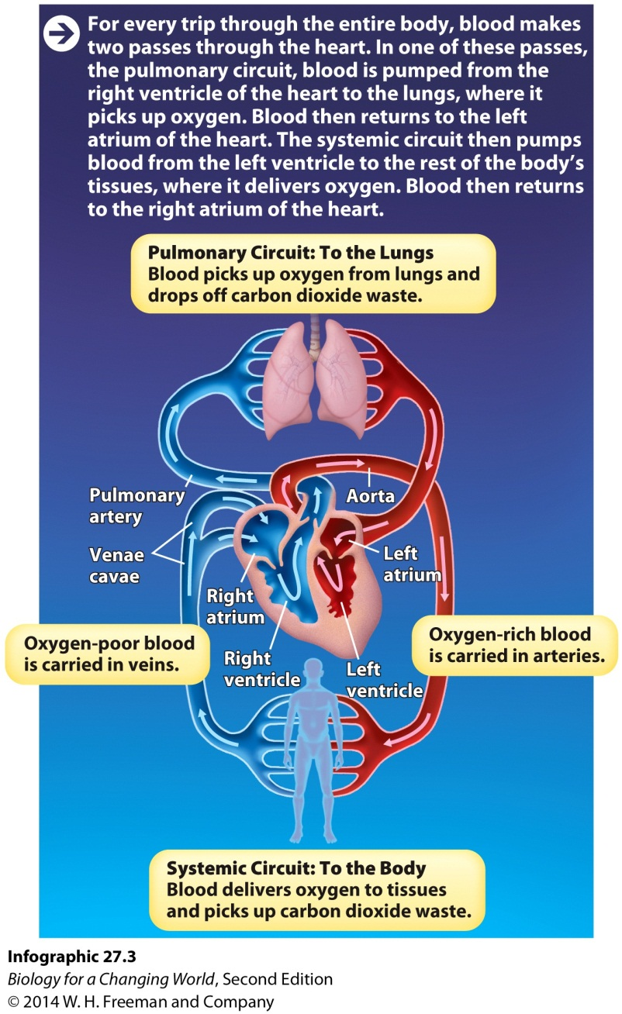
Cardiovascular function

Slide 14
Cardiovascular function
Aorta
Major heart artery leading to the rest of the body.
Carries oxygenated blood to the body’s other arteries
Heart has a set of valves in each chamber
Ensure one-way flow of blood through the heart

Slide 15
Cardiovascular function
Heart never stops beating
Regulated by pacemaker cells
60–90 beats per minute
Requires oxygenated blood for power
Notes:
The human heart beats more than 2.5 billion times in an average lifetime.

Slide 16
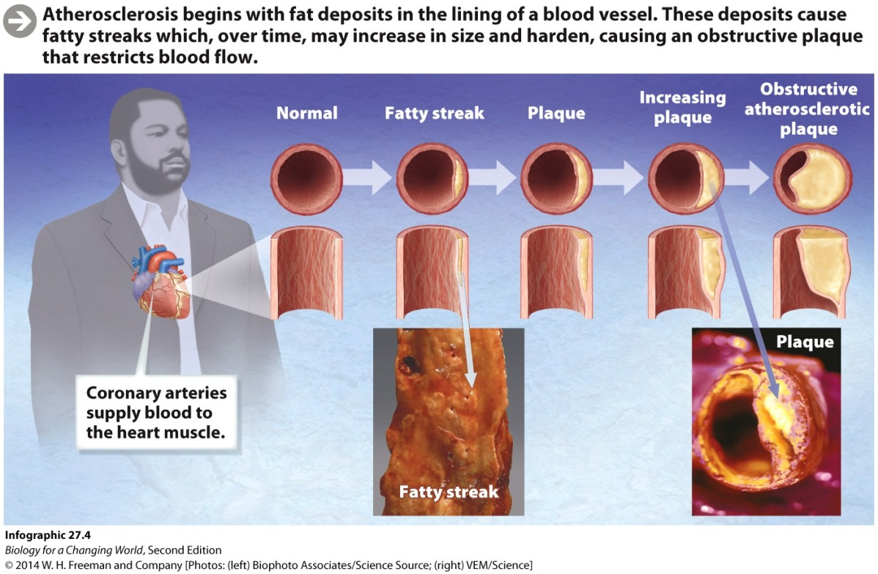
Cardiovascular disease
Atherosclerosis
Disease that restricts blood flow in vessels
Accumulation of fibrous plaques (fatty deposits)
Correlate with specific risk factors
Notes:
Plaques: raised fatty deposits that accumulate inside arteries, limiting the blood flow
Risk factors for heart disease include high blood pressure, smoking, and high cholesterol levels.

Slide 17
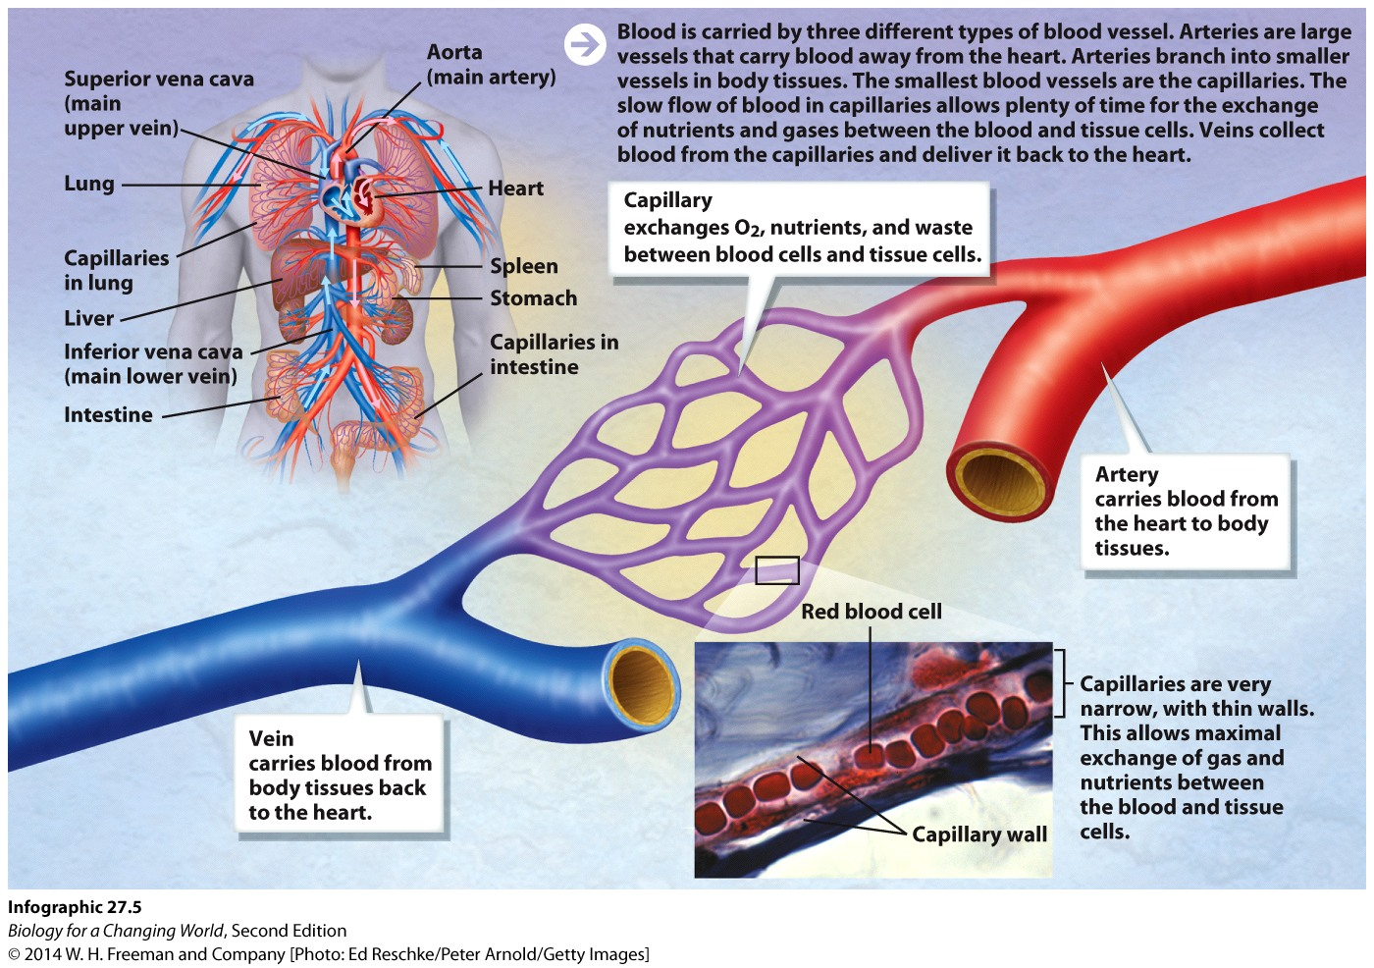
Cardiovascular function
Capillaries
Tiny blood vessels located in tissues
Site of gas and nutrient exchange
Notes:
Oxygen and nutrients diffuse out of capillaries into tissues, while carbon dioxide and wastes diffuse from tissues into capillaries.
Capillaries: the smallest blood vessels; exchange between blood and tissues

Slide 18
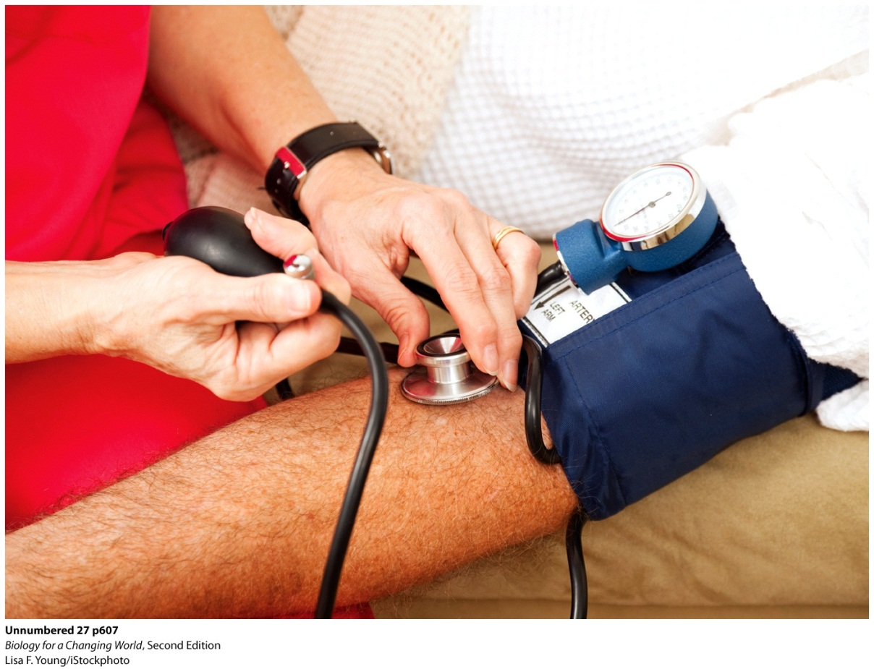
Cardiovascular function
How does blood move through blood vessels?
Arteries are high-pressure vessels; blood is propelled by the heart
Veins are low pressure vessels; rely on contractions of skeletal muscles and on one-way valves

Slide 19
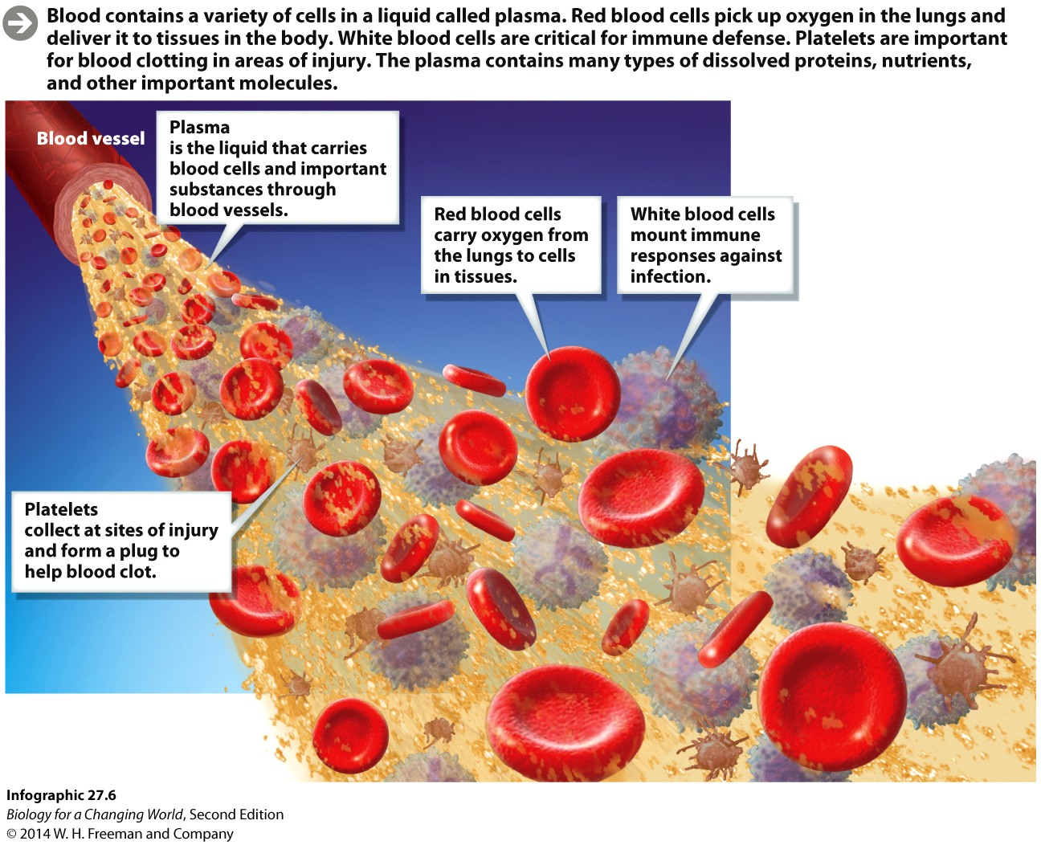
Cardiovascular function
Blood
Complex tissue
Cells
red blood cell (erythrocytes)
platelets
white blood cells (leukocytes)
Liquid plasma
water and protein
Notes:
The most important cells are the red blood cells (or erythrocytes), which are specialized for carrying oxygen; they lack a nucleus and have a distinctive concave shape.
White blood cells (or leukocytes) are involved in many aspects of the immune response.
Platelets are cell fragments that play a critical role in blood clotting.

Slide 20
Cardiovascular function
Blood pressure
Overall pressure in blood vessels
Feel in the pulse
Systolic/diastolic pressure
Relate to action of heart muscle
Notes:
The force of the blood entering the arteries can be felt as the pulse. The normal measure for blood pressure is a systolic pressure of 120 and a diastolic pressure of 80 (120/80).
Systolic pressure: the pressure in arteries when the ventricle contracts
Diastolic pressure: the pressure in arteries when the ventricle is relaxed

Slide 21
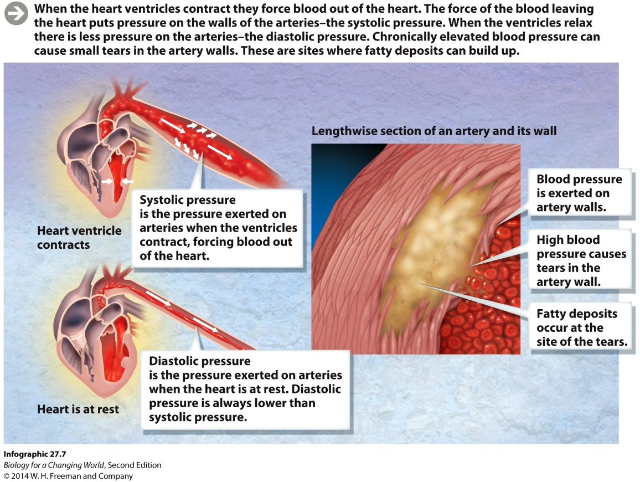
Cardiovascular disease
Hypertension
Stresses and damages walls of arteries
May develop scar tissue, then atherosclerosis

Slide 22
Cardiovascular disease
Atherosclerosis fatty deposits can also lead to blood clots
Obstruct blood flow
Stroke
disruption in blood supply to the brain.

Slide 23
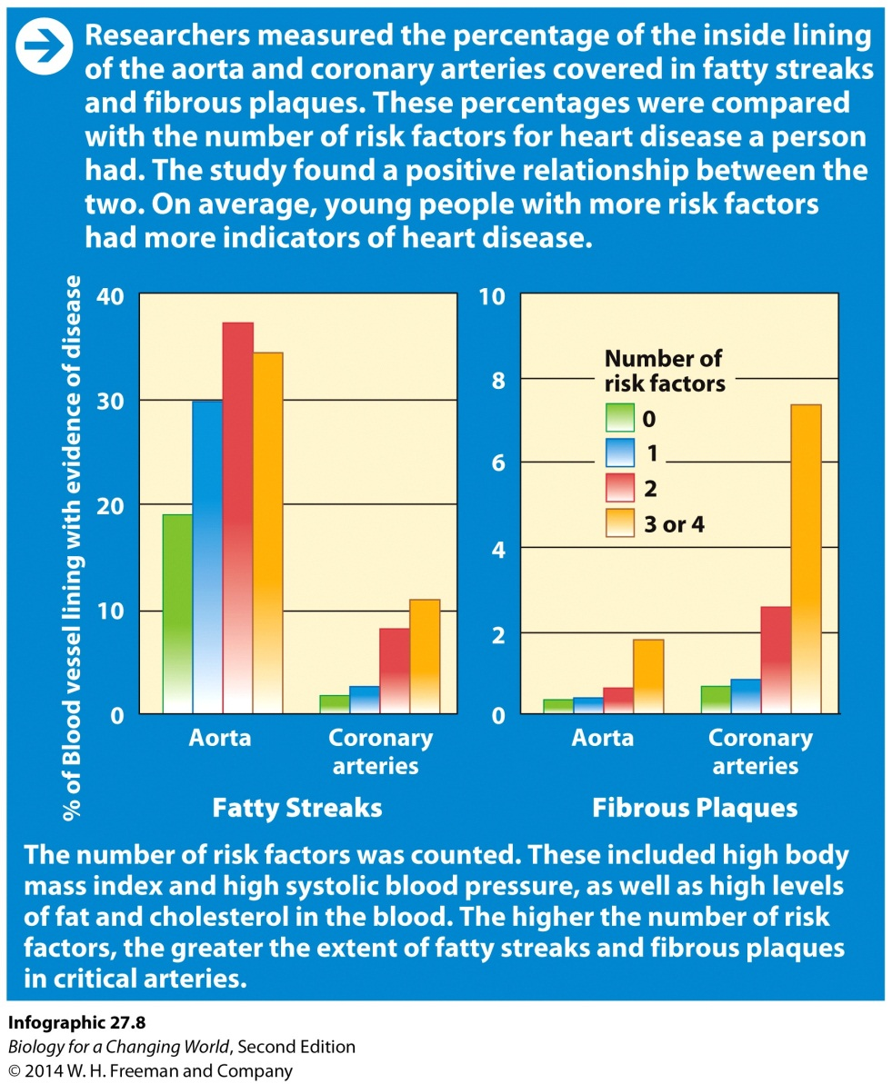
Cardiovascular disease
Risk factors
Family history of CVD
High salt diet
Obesity
Low physical activity
Drinking in excess
Stress
High cholesterol
Smoking cigarettes
Notes:
The amount and extent of atherosclerosis increases with age and is strongly correlated with the known risk factors for heart disease.
Cholesterol: a lipid that is transported in the blood by specialized proteins

Slide 24
Risk factors
Cholesterol
Lipid transported in the blood
Proteins bind and help transport it
lipoproteins (LDL and HDL)
Notes:
Cholesterol is not inherently harmful. In fact, it is a critical constituent of cell membranes, as well as a precursor to the synthesis of many hormones.
Low-density lipoprotein (LDL) carries cholesterol to body cells, and can accumulate on linings of blood vessels, contributing to atherosclerosis. High-density lipoprotein (HDL) helps carry cholesterol out of blood vessels and deliver it to the liver where it is processed.
Once cholesterol is deposited, other events lead to fatty streaks. Once these deposits become raised, they are known as plaques.
HDL is “good” cholesterol and LDL is “bad” cholesterol. Too much LDL relative to the amount of HDL in the blood leads to cholesterol deposits in blood vessels.

Slide 25
Risk factors
Obesity
BMI of 30 or above
Heart works harder
Leads to high blood pressure
Type 2 diabetes
Notes:
Diabetes: a disease characterized by chronically elevated levels of blood sugar
The obesity rates in the United States have skyrocketed since the 1980s. Nearly 36% of adults and 17% of children in the United States are obese (BMI ≥ 30), according to the Centers for Disease Control.

Slide 26
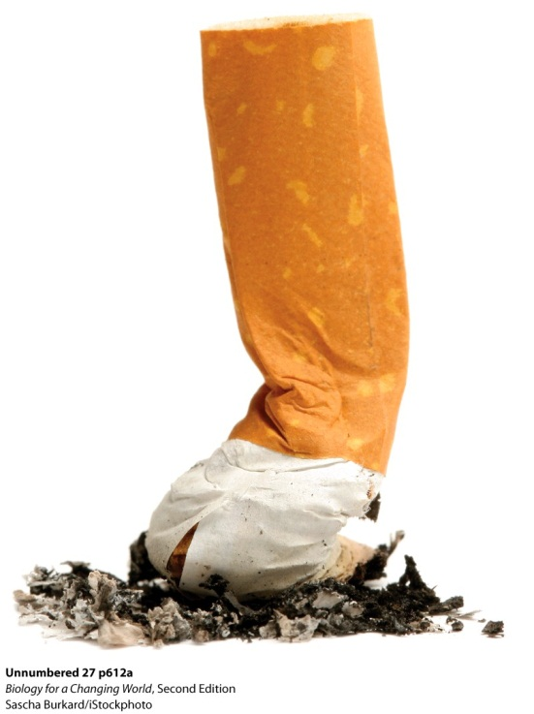
ABCs of a healthy heart
Notes:
Eating better, quitting smoking, and increasing one’s activity level can positively affect cholesterol levels and reduce BMI.

Slide 27
Other types of circulatory systems
Unicellular organisms
Exchange gases across the cell membrane by diffusion
Multicellular organisms
Too large for diffusion
Require a cardiovascular system
Notes:
Diffusion: the movement of dissolved substances from an area of high concentration to an area of low concentration

Slide 28
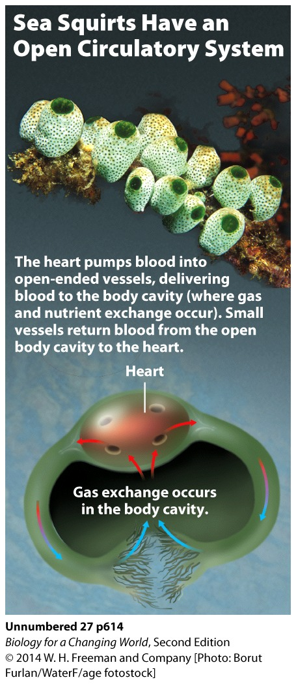
Other types of circulatory systems
Open circulatory systems
Blood is not entirely contained within blood vessels
Notes:
Open circulatory system: a circulatory system in which the blood is not entirely contained within blood vessels
Closed circulatory system: a circulatory system in which the blood remains in the blood vessels at all times

Slide 29
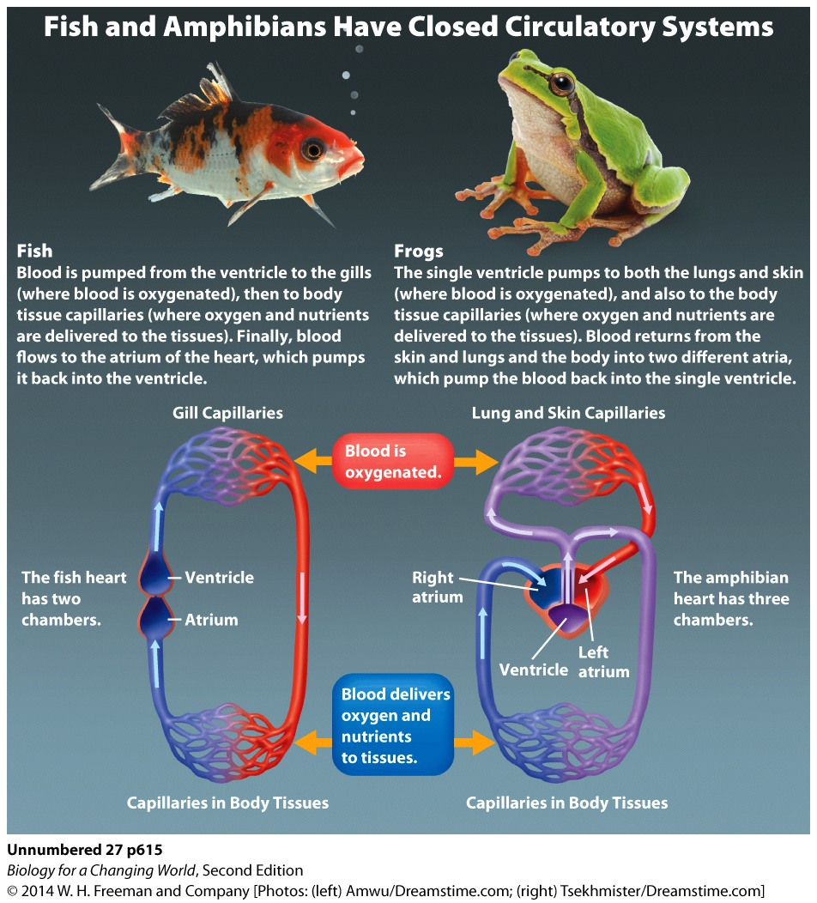
Other types of circulatory systems
Closed circulatory systems
Blood remains in the blood vessels at all times
Many variations
Notes:
Open circulatory system: a circulatory system in which the blood is not entirely contained within blood vessels
Closed circulatory system: a circulatory system in which the blood remains in the blood vessels at all times

Slide 30
Summary
The cardiovascular system transports nutrients, oxygen, and hormones and consists of the heart, blood vessels, and blood.
The heart acts as a pump, moving blood in two circuits between the heart and lungs (pulmonary circuit) and between the heart and the rest of the body (systemic circuit).
Arteries transport blood away from the heart, veins transport blood to the heart, and capillaries are the sites of nutrient and gas exchange in tissues.
Blood is composed of cells and fluid.
Atherosclerosis is common form of cardiovascular disease.
High blood pressure, obesity, high cholesterol, and smoking are known risk factors for atherosclerosis.

