Slide 1
Michèle Shuster • Janet Vigna • Gunjan Sinha • Matthew Tontonoz
Biology for a
Changing World
SECOND EDITION
Lecture PowerPoint
CHAPTER 28
Respiratory System
Copyright © 2014 by W. H. Freeman and Company

Slide 2
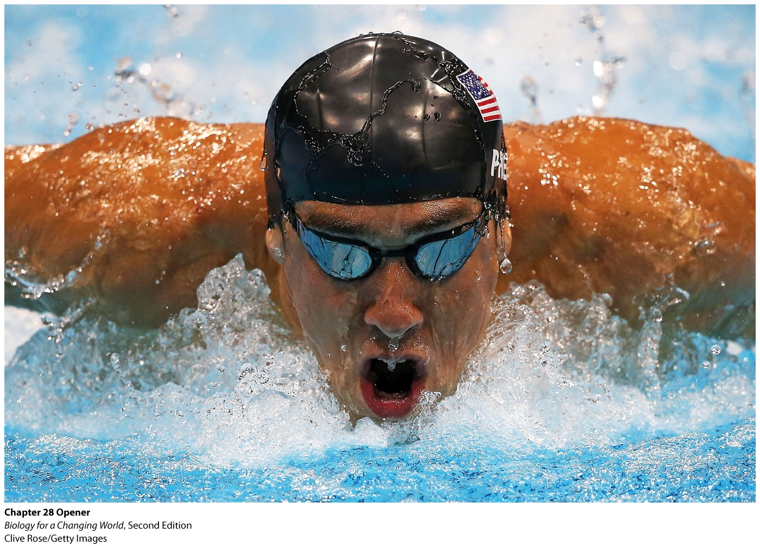
Chapter 28
Respiratory System

Slide 3
Driving Questions
1. What structures make up the respiratory system?
2. How do the respiratory and cardiovascular systems cooperate
to deliver oxygen to body cells and remove carbon dioxide from
tissues?
3. What factors influence the oxygen-carrying capacity of blood
and breathing rate?
4. How can scientific knowledge of the respiratory system be
used to design training regimens for elite athletes?

Slide 4
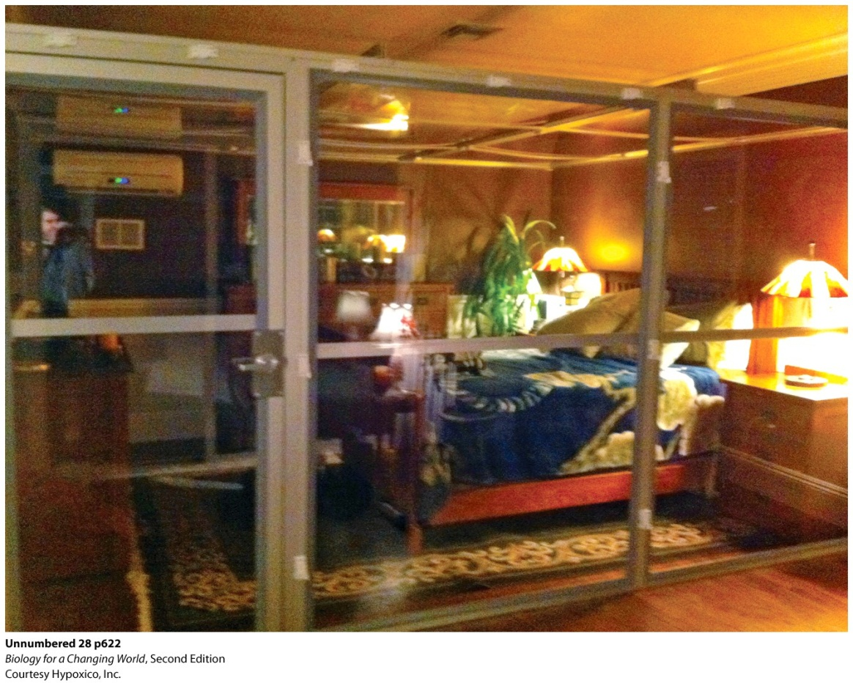
Technology to improve performance
Hypoxic chamber
Low-oxygen chamber
Used by Olympic swimmer Michael Phelps
Central part of training and healing regiment
Acclimatization
Notes:
A hypoxic chamber like the one in Michael Phelps’s bedroom.
What does sleeping in a low-oxygen chamber have to do with athletic performance? It’s a variation on the theme of natural altitude training. Athletes spend several weeks living at high altitude, typically defined as 6,000 feet or more above sea level, and then return to sea level to train or compete. The widely used practice is based on the idea that the body will acclimatize to higher elevation by becoming better able to take up and transport oxygen, ultimately improving performance.

Slide 5
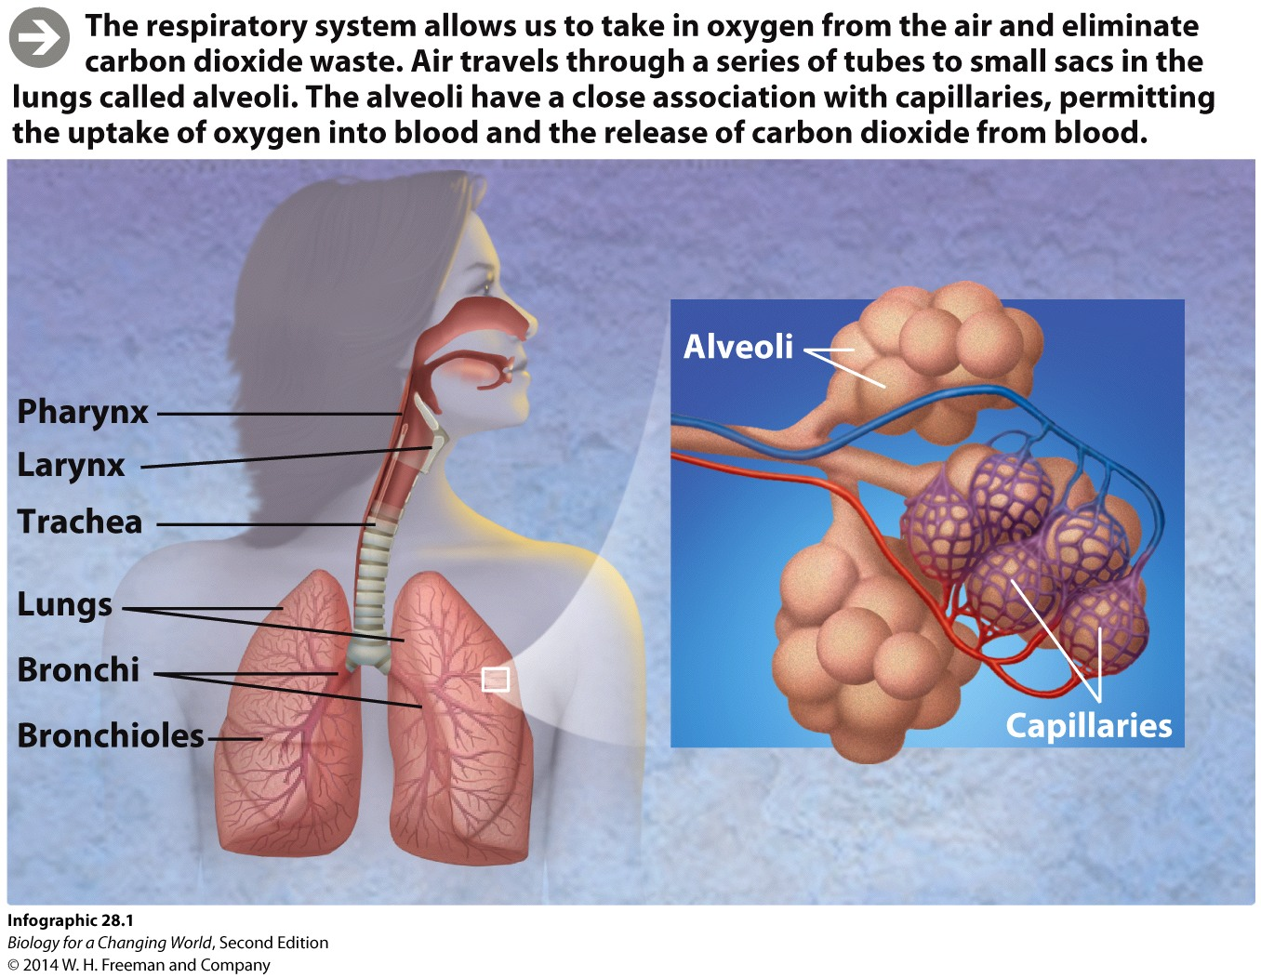
The respiratory system
Takes oxygen in and releases carbon dioxide
Pharynx
Larynx
Trachea
Lungs
Bronchi

Slide 6
The respiratory system
Air passes through the
Pharnyx or throat
Larynx or voicebox
Trachea or windpipe
Two bronchi
Lungs
Notes:
Pharynx: the throat
Larynx: the opening to the lower respiratory tract; also known as the voicebox; houses vocal cords
Trachea: a large airway leading into the lower respiratory tract
Bronchi: two airways that branch from the trachea; one bronchus leads into each lung

Slide 7
The respiratory system
Lungs
Major respiratory organ
Site of gas exchange between air and blood
Bronchi branch into bronchioles
Alveoli
Notes:
Tubes continue to branch and split into smaller and smaller bronchioles until air hits the many tiny sacs called alveoli, located deep within the lungs.
Bronchioles: smaller airways that branch from the bronchi
Alveoli: air sacs in the lungs; oxygen exchange in the lungs takes place across the membranes of alveoli
Alveoli are closely associated with capillaries, permitting oxygen and carbon dioxide to be exchanged between the air and the blood.

Slide 8
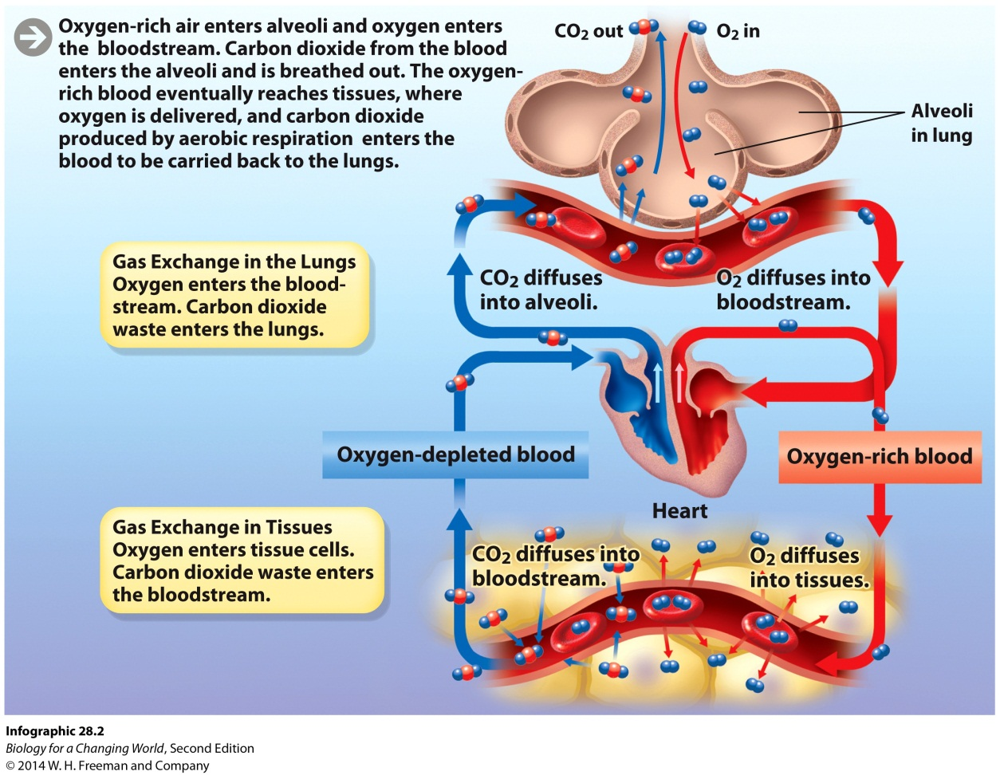
The respiratory system
Respiratory surface
Surface across which oxygen enters and carbon dioxide leaves
Alveoli are site of gas exchange between air and blood
Notes:
The respiratory surface is enormous: if all the alveoli were splayed out flat, they would occupy an area about the size of a tennis court. Alveoli provide the means by which oxygen enters the blood.

Slide 9
Altitude, oxygen, and blood
Cardiorespiratory system
Respiratory and cardiovascular systems work in close coordination
At higher altitude
Less pressure
Increase number of oxygen-carrying red blood cells
Take up same amount of oxygen
Shift to lower altitude
More red blood cells, better oxygen use
Notes:
Red blood cells (RBCs): blood cells specialized for transporting oxygen throughout the body

Slide 10
Altitude, oxygen, and blood
Notes:
Lower oxygen levels actually help an athlete in the long run, because of the way the body responds to the altered conditions.

Slide 11
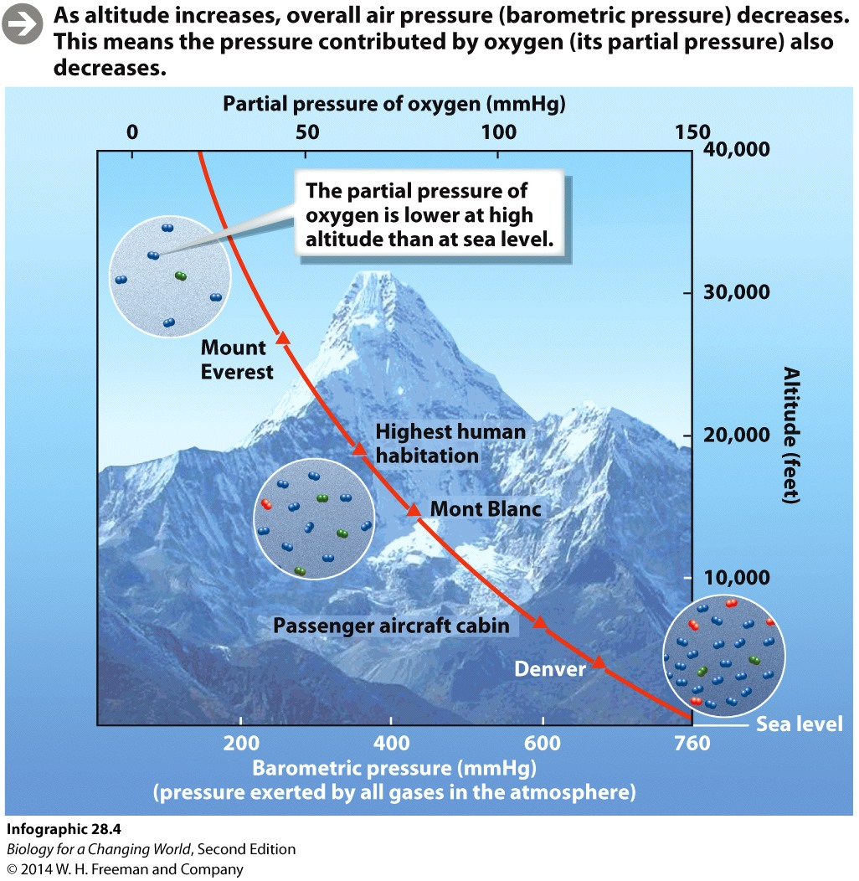
Altitude, oxygen, and blood
Hypoxic chambers
simulate altitude
artificially reducing amount of oxygen
partial pressure
Notes:
Partial pressure: The proportion of total air pressure contributed by a given gas

Slide 12
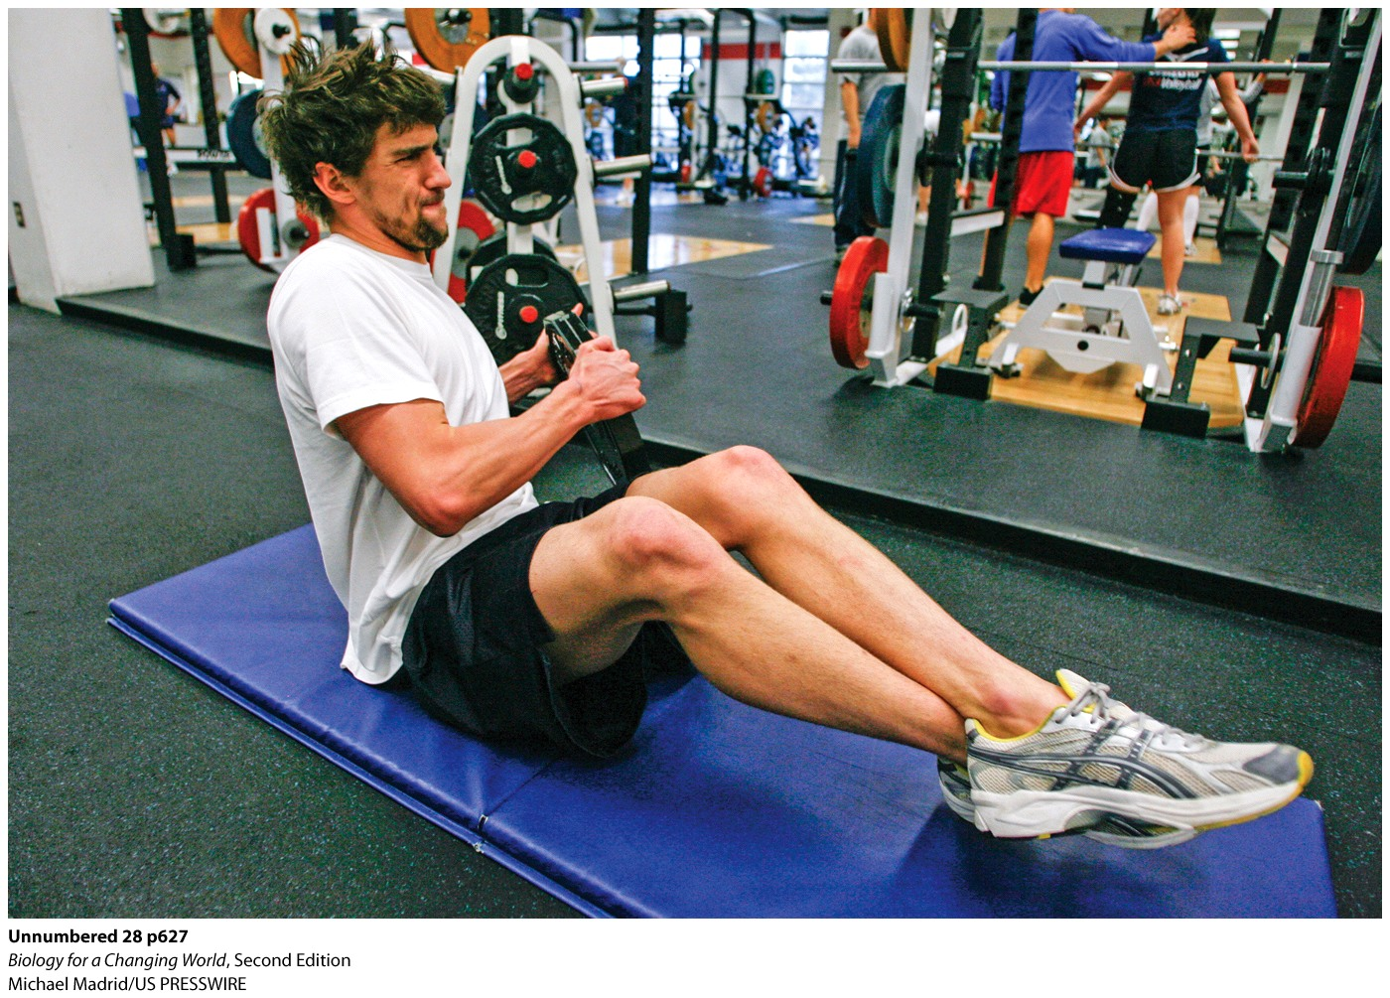
Altitude, oxygen, and blood
Phelps experiences lower oxygen while he sleeps
Stimulates his body to produce RBCs
Trains at normal, vigorous levels during the day
Notes:
Michael Phelps training at the U.S. Olympic Training Center in Colorado Springs, Colorado.

Slide 13
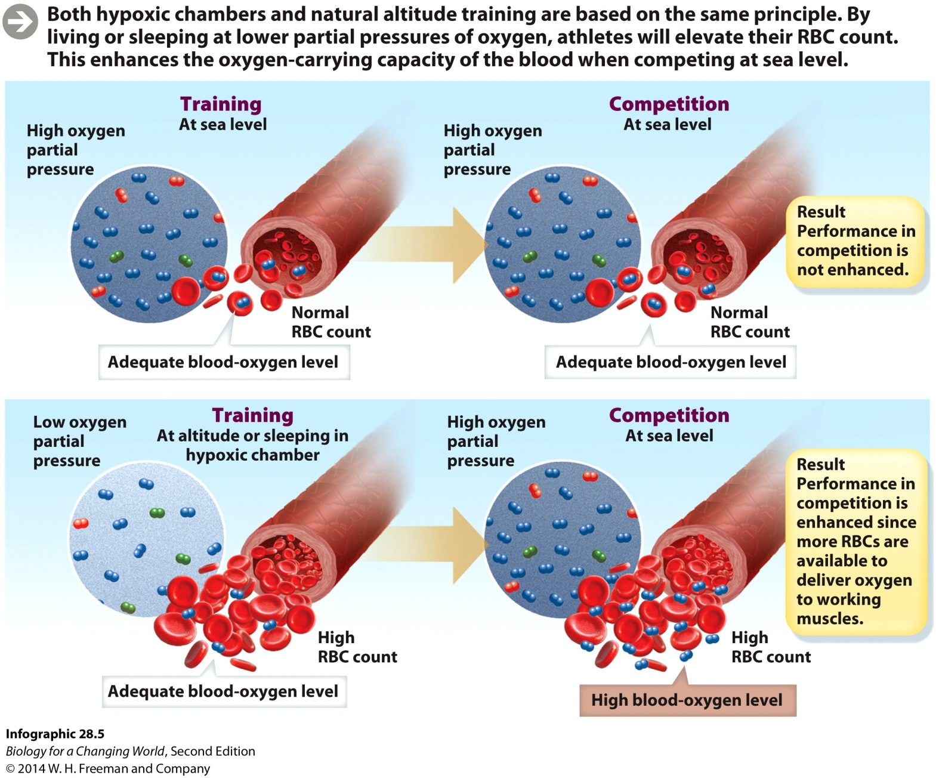
Altitude, oxygen, and blood
Notes:
Someone coming from sea level, who lacked these adaptations, would have a hard time thriving at these elevations, and may in fact succumb to altitude sickness. Wilber notes that some athletes find that the chamber gives them headaches or that they have trouble sleeping.
Altitude sickness: an illness that can occur as a result of an abrupt move to an altitude with a reduced partial pressure of oxygen

Slide 14
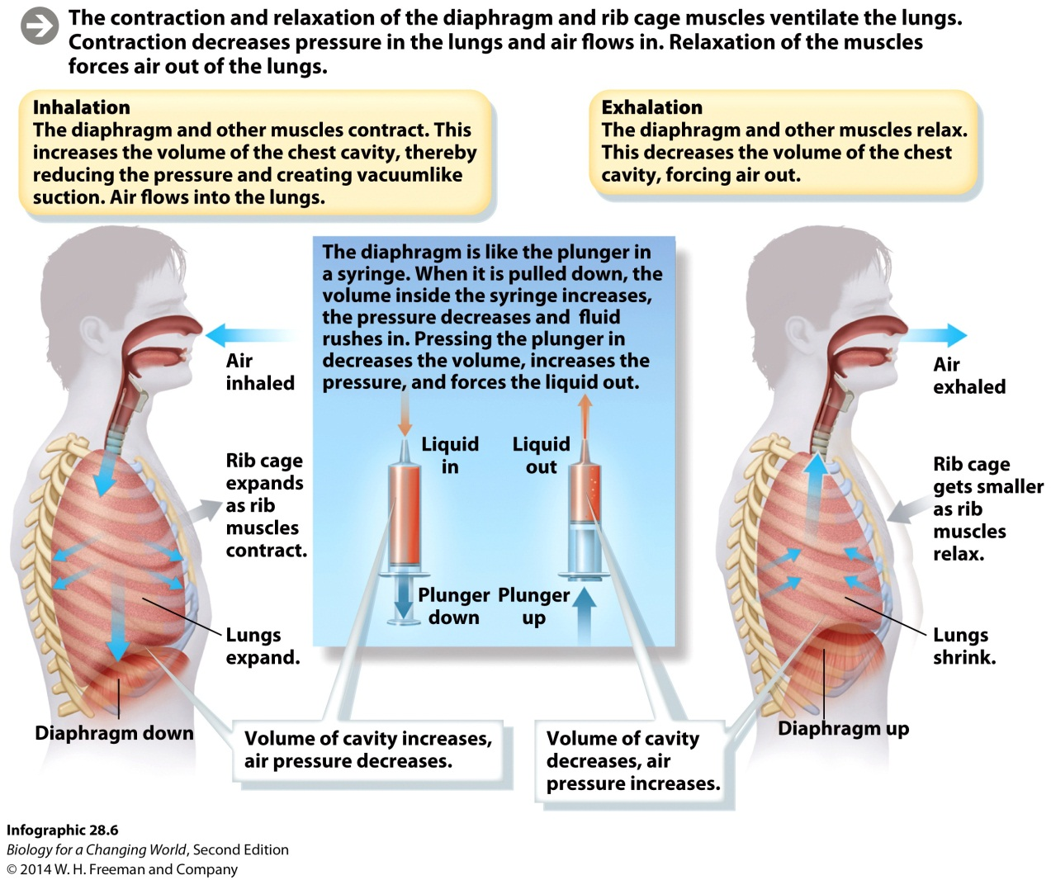
Breathing
Process of ventilating lungs; required for gas exchange
Diaphragm: a sheet of muscle that contracts and relaxes
Notes:
The diaphragm works in coordination with other muscles connected to the rib cage. Inhalation increases the size of the chest cavity overall. This sudden increase in the volume of the chest cavity has the effect of decreasing air pressure there, creating suction that draws air into the lungs. If a person is unable to unload carbon dioxide from the lungs, the concentration of carbon dioxide in the blood can rise to dangerous levels, creating a potentially fatal condition known as acidosis.
Ventilation: the process of moving air in and out of the lungs
Exhalation: As the muscles relax, the chest cavity contracts, and air is expelled

Slide 15
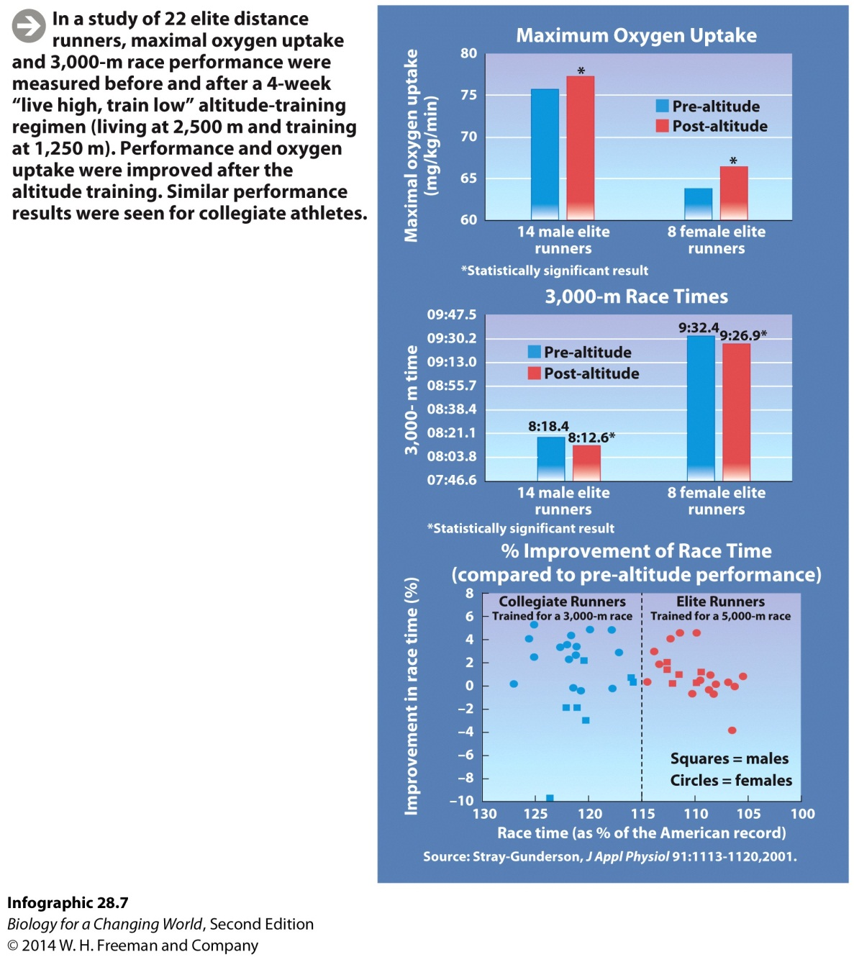
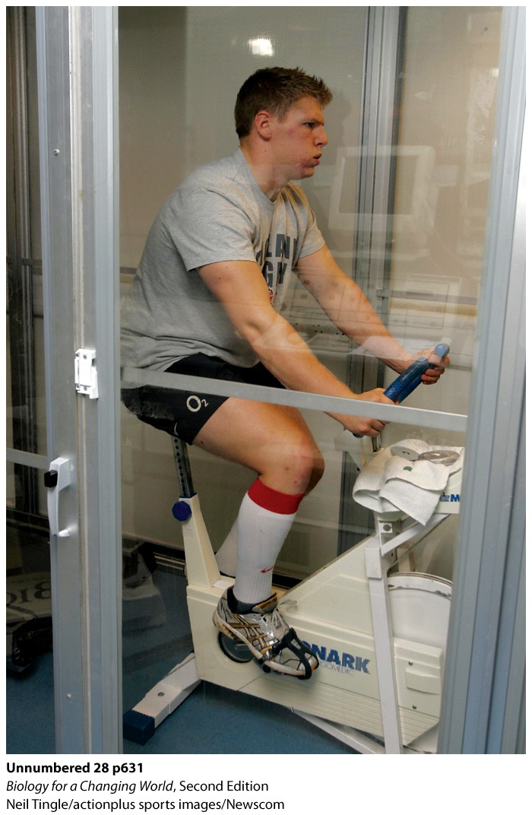
Does altitude training work?
Notes:
A hypoxic workout chamber at a popular gym chain. Any gains in performance are likely to be small, so how can you be sure the gains were due to high altitude and not some other aspect of training? It is difficult to design properly controlled studies.

Slide 16
Hemoglobin carries oxygen
Hemoglobin
Protein in red blood cells specialized for transporting oxygen
Heme group: oxygen-binding part
Notes:
Hemoglobin: a protein found in red blood cells specialized for transporting oxygen
Heme group: iron-containing structures on hemoglobin, the sites of oxygen binding
Each hemoglobin has four heme groups, so each hemoglobin molecule can carry up to four molecules of O₂. Hemoglobin can bind O₂ in the lungs and release O₂ in the tissues.

Slide 17
Hemoglobin carries oxygen
Temperature and pH affect oxygen binding
Notes:
Hemoglobin is more likely to release oxygen as temperature increases, but pH plays a role. At lower pH, hemoglobin releases oxygen. One of the main things that can lower pH is the concentration of CO₂.

Slide 18
Blood doping
Erythropoietin (EPO)
Hormone that stimulates RBC production
Notes:
With more RBCs, the body increases its ability to absorb and transport oxygen.
Blood doping: artificially increasing the concentration of RBCs in their blood by undergoing blood transfusions or by injecting themselves with synthetic EPO

Slide 19
Blood doping
Notes:
Blood doping became endemic in cycling and caused a major scandal in 1998, when it was discovered that many cyclists were using EPO. That scandal led to the formation of the World Anti-Doping Agency (WADA) in 1999.
Cyclist and seven-time Tour de France winner Lance Armstrong, who admitted to doping and had his titles stripped in 2012, managed to avoid being tested numerous times.

Slide 20
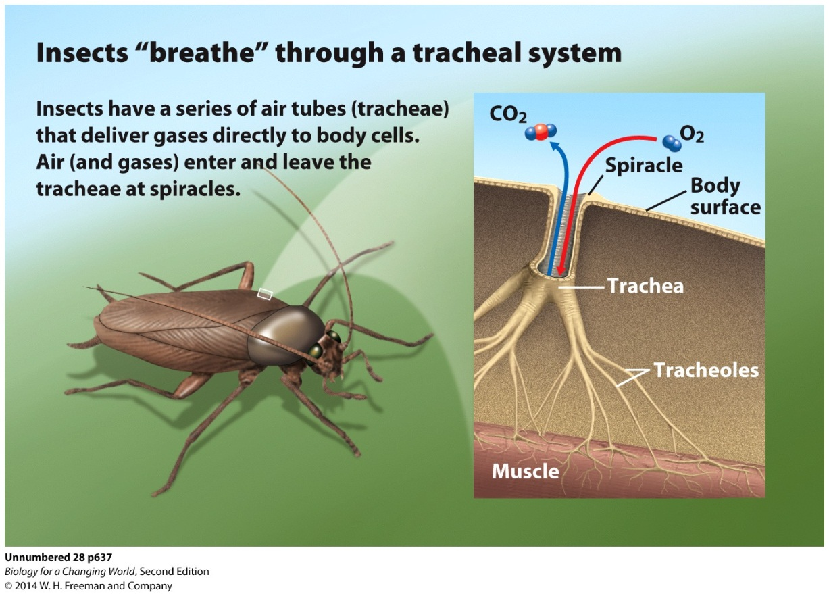
How do creatures “breathe” without lungs?
Tracheal system
A vast network of air-filled tubes that bring in air from the body surface to individual cells
Notes:
The tracheae branch into smaller and smaller tubes, resulting in a highly branched network that brings air very close to every cell in the body. Oxygen and carbon dioxide diffuse directly from the air tubes to the body cells, which means there is no need for a circulatory system to shuttle gases to and from cells.

Slide 21
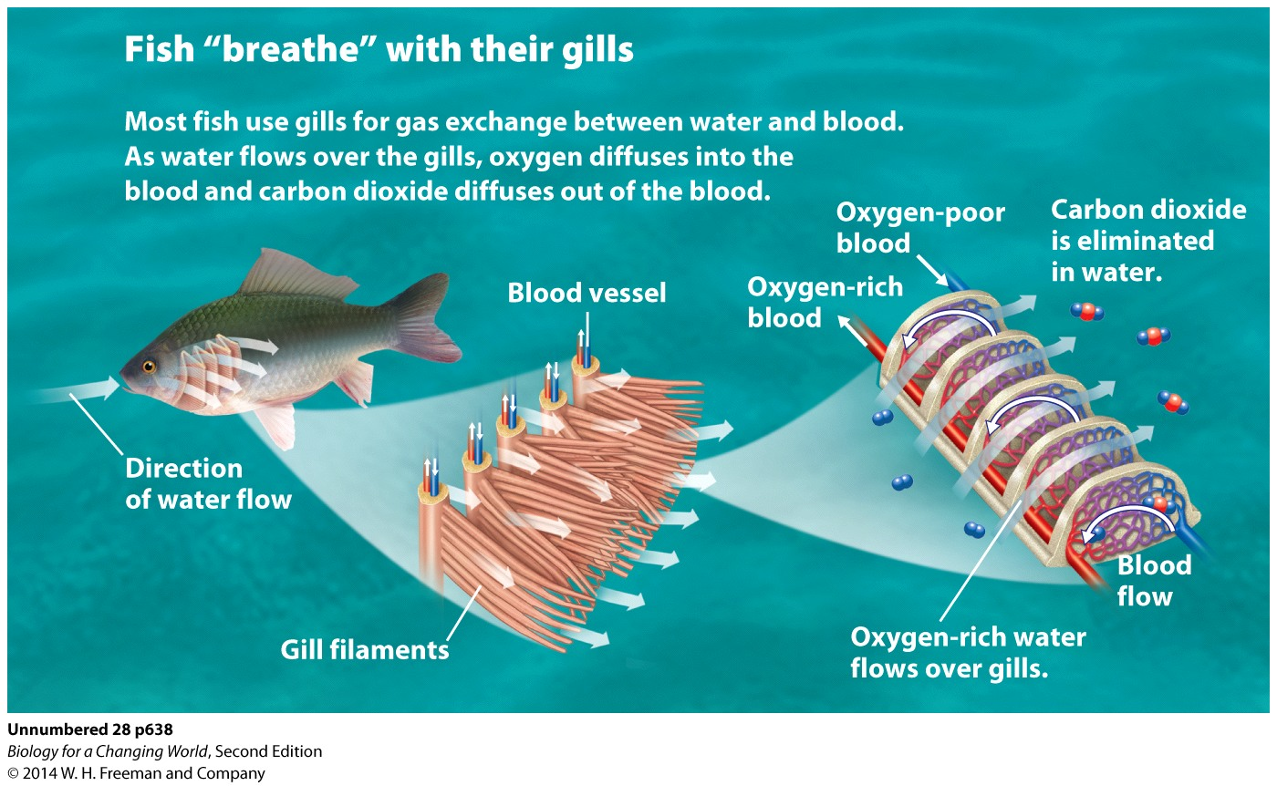
How do creatures “breathe” without lungs?
Gills
Delicate tissues that allow the fish to extract oxygen from water
Notes:
As water flows over gills, oxygen diffuses directly into the blood and is carried through the body. Fish move water over their gills in a one-way direction. Water enters through the mouth, is forced over the gills. The more water they can move over their gills, the more oxygen they can extract from the water, and the more oxygen can be carried to cells for use in cellular respiration.

Slide 22
Summary
The respiratory system is a means of taking in oxygen and eliminating carbon dioxide waste. It consists of the respiratory tract and the lungs.
The respiratory system works in close conjunction with the cardiovascular system. Capillaries in the alveoli of the lungs are the sites of gas exchange between air and blood.
Breathing is the way we ventilate our lungs and bring fresh air to the sites of gas exchange.
Oxygen is carried by hemoglobin in red blood cells. Hemoglobin binds reversibly to oxygen, picking it up from the lungs and dropping it off in tissues.

