Slide 1
Biology for a Changing World, 2e Clicker Questions Chapter 30

Slide 2
Which represents the number of couples have difficulty becoming pregnant (unable to conceive within 1 year or bring a pregnancy to term)?
1 in 8
1 in 10
1 in 15
1 in 20
1 in 15
Notes:
2
Answer: A
Answer notes: See page 668
Driving Question: 3
2

Slide 3
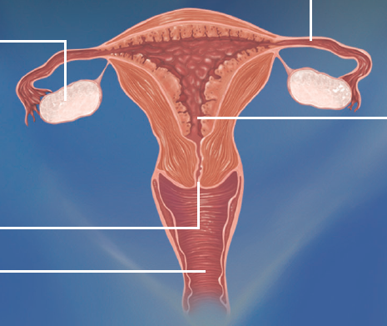
The blue, purple, and red arrows, in that order, point to the
uterus; vulva; vagina
vulva; ovaries; vagina
urethra; cervix; vagina
vagina; cervix; uterus
urethra; vagina; uterus
Notes:
3
Answer: D
Answer notes: See page 667
Driving Question: 1
3

Slide 4
Where is the endometrium found?
prostate
vas deferens
ovary
testis
None of the above.
Notes:
4
Answer: E
Answer notes: See page 667
Driving Questions: 1
4

Slide 5
Which of the following is an androgen?
testosterone
estrogen
progesterone
Both A and C.
None of the above.
Notes:
5
Answer: A
Answer notes: See page 668
Driving Question: 2
5

Slide 6
Where are seminiferous tubules found?
prostate
vas deferens
ovary
testis
None of the above.
Notes:
6
Answer: D
Answer Notes: See page 668
Driving Question: 1
6

Slide 7
Semen is produced, in part, by which organ(s)?
only one testis at a time
only one testis at a time and the bladder
both testes
both testes and the prostate
both testes and the vas deferens
Notes:
7
Answer: D
Answer Notes: See page 668
Driving Question: 1
7

Slide 8
Where does successful fertilization of an egg occur?
ovaries
oviducts
uterus
vagina
Any of the above.
Notes:
8
Answer: B
Answer Notes: See page 669
Driving Question: 1
8

Slide 9
A successfully fertilized egg is called a(n) _______, which must next implant in the ________.
embryo; uterus
zygote; uterus
fetus; vagina
zygote; vagina
fetus; cervix
Notes:
9
Answer: B
Answer Notes: See pages 669 and 670
Driving Question: 1
9

Slide 10
Which of the following is NOT a drawback of in vitro fertilization (IVF) due to the risk of multiple births?
increased risk of health problems for the mother
increased risk of infant mortality to children
increased risk of later life health problems for the children
increased burden on health care system in case of multiple births
All of the above are potential drawbacks.
Notes:
10
Answer: E
Answer notes: See pages 669 and 670
Driving Question: 3
10

Slide 11
Which hormone is produced by the ovaries to prepare and maintain the uterus for pregnancy?
testosterone
estrogen
progesterone
Both A and C.
None of the above.
Notes:
11
Answer: C
Answer Notes: See page 671
Driving Question: 2
11

Slide 12
The release of an egg by the ovary is triggered by which hormone?
estrogen
progesterone
luteinizing hormone
follicle-stimulating hormone
human chorionic gonadotropin
Notes:
12
Answer: C
Answer Notes: See page 671
Driving Question: 2
12

Slide 13
The hormone that signals to the reproductive system that pregnancy has occurred is _______; this hormone is secreted by the ________.
progesterone; uterus
human chorionic gonadotropin; zygote
progesterone; corpus luteum
follicle-stimulating hormone; uterus
human chorionic gonadotropin; ovaries
Notes:
13
Answer: B
Answer Notes: See pages 671-673
Driving Question: 2
13

Slide 14
Sperm can survive in the female reproductive tract for up to ________; an egg must be fertilized within ______ after ovulation.
24 hrs.; 24 hrs.
1 week; 1 week
3 days; 3 days
1 week; 24 hrs.
24 hrs.; 1 week
Notes:
14
Answer: D
Answer Notes: See page 671
Driving Question: 1
14

