Slide 1
chapter 11
An Introduction to Patterns of Development

Slide 2
Contents of Chapter 11
An Overview of the Patterns of Development
Narration
Description
Illustration
Process Analysis
Comparison and Contrast
Classification and Division
Extended Definition
Cause and Effect
Argument
Writing an Essay that Combines the Patterns of Organization

Slide 3
Narration
Uses a sequence of events – a story – to make a point.
Use it when you want readers to learn by experiencing a story from your life.
Description
Uses words that appeal to the sense to paint a picture.
Use it when you want to emphasize a sensory experience.
An Overview of the
Patterns of Development

Slide 4
Illustration
Uses examples to explain unfamiliar topics, concepts, or terms.
Use it when you want to provide specific examples to support your main ideas.
Process Analysis
Uses step-by-step descriptions to explain how something works, is done, or is made.
Use it when you want to provide step-by-step instructions or analysis.

Slide 5
Comparison and Contrast
Uses an examination of two (or more) things to show what they have in common or what their differences are.
Use it when you want to provide an in-depth analysis of the similarities and/or differences between two things.
Extended Definition
Uses detail to explain how a term is used or differentiates among its shades of meaning.
Use it when you want to conduct a close analysis of a complicated word, phrase, or phenomenon.

Slide 6
Cause and Effect
Analyzes the reasons an event or phenomenon happens or the results of the event or phenomenon.
Use it when you want to show how one (or more) thing(s) leads to another or many other things.
Argument
Used to persuade readers to adopt (or at least consider) the writer’s position.
Use it when you want to convince your readers that your point of view is correct or when you want them to take action.

Slide 7
Some essays use only one pattern, but many essays and writing projects combine several patterns.
Writing an Essay that Combines the Patterns of Organization
Use Chapters 12-21 for detailed instructions on how to write using each pattern as well as how to write a mixed-mode essay.
Combining the Patterns

Slide 8
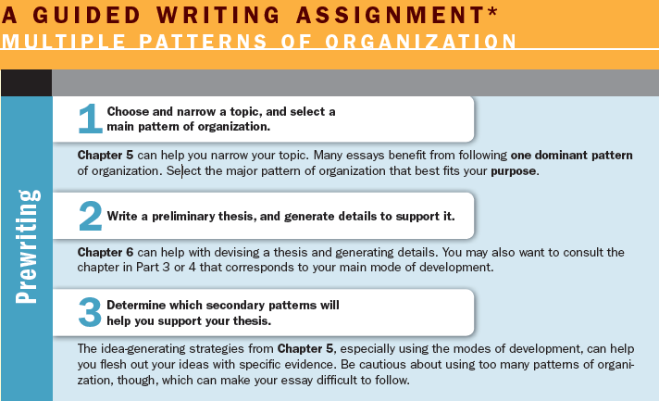
(continued)

Slide 9
