Slide 1
chapter 14
Illustration: Explaining with Examples

Slide 2
Contents of Chapter 14
Characteristics of Illustration Essays
Reading: “The Brains of the Animal Kingdom,” by Frans de Waal
Visualizing an Illustration Essay: A Graphic Organizer
Reading: “Rambos of the Road,” by Martin Gottfried
Integrating Illustration into an Essay
Reading Actively and Thinking Critically
What to Look For, Highlight, and Annotate
Analyzing Illustration
A Guided Writing Assignment

Slide 3
Contents for Chapter 14
Readings: Illustration in Action
Student Essay: “Conforming to Stand Out: A Look at American Beauty,” by Nick Ruggia
Illustration Essay: “Snoopers at Work,” by Bill Bryson
Illustration Combined with Other Patterns: “Alone Together: Why We Expect More from Technology and Less from Each Other,” by Sherry Turkle
Applying Your Skills: Additional Essay Assignments

Slide 4
What is Illustration?
Illustration is a way of using examples to reveal the essential characteristics of a topic or to reinforce a thesis.

Slide 5
Characteristics of
Illustration Essays
Illustration
supports generalizations.
explains or clarifies
unfamiliar topics.
difficult concepts.
abstract terms.
considers purpose and audience.
uses carefully selected examples.
uses subexamples to add detail.
organizes details effectively.
Reading
“The Brains of the Animal Kingdom,” by Frans de Waal

Slide 6
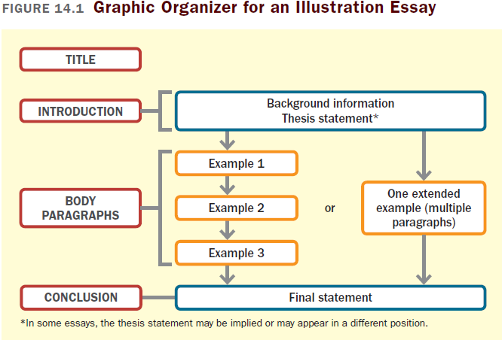

Slide 7
Reading
“Rambos of the Road,” by Martin Gottfried

Slide 8
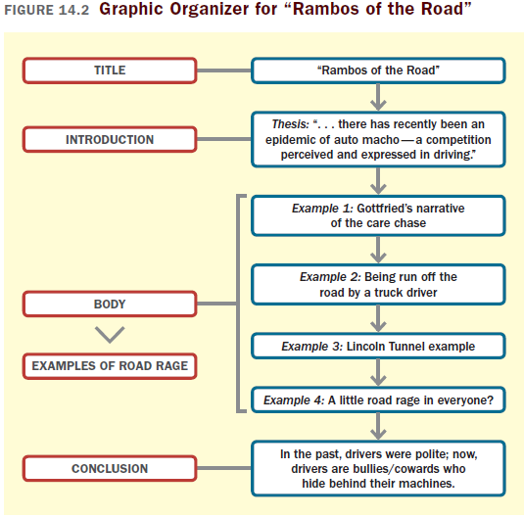

Slide 9
Integrating Illustration into
An Essay
Choose effective examples.
Use transitions such as “for instance” or “for example.”
Provide enough details about the example to support your point.

Slide 10
Reading Actively and
Thinking Critically
What to Look For, Highlight, and Annotate
Preview.
Understand the main point.
Identify the main supporting points and think about how the examples illustrate them.
Think about the meaning.
Consider your reactions.
Analyzing Illustration
What is the emotional impact of the examples?
How well do the examples support the generalization?

Slide 11
A Guided Writing Assignment
Your Essay Assignment
Prewriting
Select a topic.
Consider your purpose, audience, and point of view.
Narrow your topic and generate examples
Evaluate your examples.
(continued)

Slide 12
A Guided Writing Assignment
Organizing and Drafting
Draft your thesis statement.
Choose a method of organization.
Write a first draft of your illustration essay.
Revising
Evaluate your draft and revise as necessary.
Editing and Proofreading
Edit and proofread your essay.

Slide 13
