Slide 1
chapter 15
Process Analysis: Explaining How Something Works or is Done

Slide 2
Contents of Chapter 15
Characteristics of a Process Analysis Essay
Reading: “How Not to Say the Wrong Thing,” by Susan Silk and Barry Goldman
Visualizing a Process Analysis Essay: A Graphic Organizer
Reading: “Shitty First Drafts,” by Anne Lamott
Integrating Process Analysis into an Essay
Reading Actively and Thinking Critically
What to Look For, Highlight, and Annotate
Analyzing Process Analysis
A Guided Writing Assignment

Slide 3
Contents for Chapter 15
Readings: Process Analysis in Action
Student Essay: “Going Vegan: How to Have Your Eggless Cake, and Eat It, Too,” by Justine Appel
Process Analysis Essay: “Dater’s Remorse,” by Cindy Chupak
Process Analysis Combined with Other Patterns: “The Psychology of Stuff and Things,” by Christian Jarrett
Applying Your Skills: Additional Essay Assignments

Slide 4
What Is Process Analysis?
A process analysis explains in step-by-step fashion how something works or how something is done or made.

Slide 5
Characteristics of
Process Analysis Essays
Process Analysis
usually includes an explicit thesis statement.
is organized chronologically.
provides background information helpful to readers.
provides an appropriate level of detail.
anticipates trouble spots and offers solutions.
Reading
“How Not to Say the Wrong Thing,” by Susan Silk and Barry Goldman

Slide 6
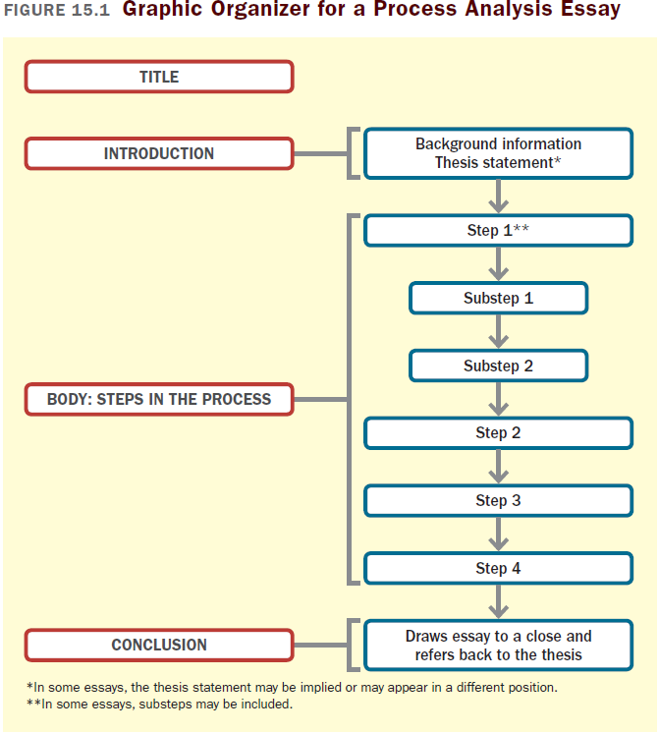

Slide 7
Reading
“Shitty First Drafts,” by Anne Lamott

Slide 8
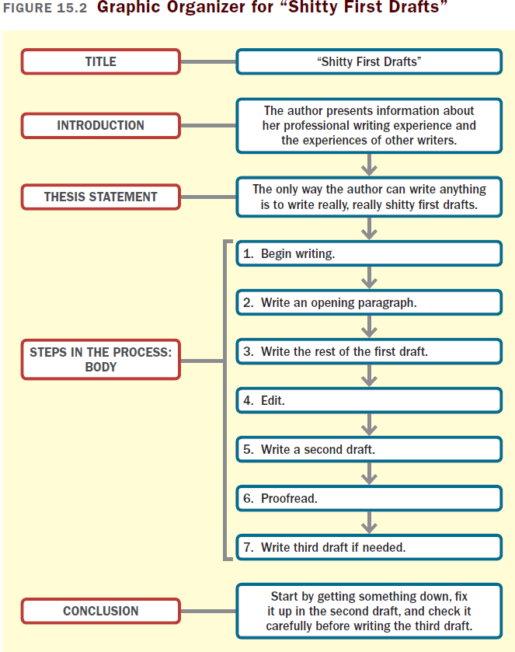

Slide 9
Integrating Process Analysis
into an Essay
Explain only the major steps.
Introduce the process analysis with a transitional sentence.
Consider using the word process or procedure.
Once you have completed the process analysis, alert readers that you are returning to the main topic.

Slide 10
Reading Actively and
Thinking Critically
What to Look For, Highlight, and Annotate
Preview.
Identify the process.
Understand the steps in the process.
Think about the meaning.
Consider your reactions.
Analyzing Process Analysis
What are the writer’s motives?
Is the writer knowledgeable and experienced?
Have any steps or important details been omitted?

Slide 11
A Guided Writing Assignment
Your Essay Assignment
Prewriting
Select a topic.
Consider your purpose, audience, and point of view.
Explore your subject and generate details.
(continued)

Slide 12
A Guided Writing Assignment
Organizing and Drafting
Draft your thesis statement.
Organize your essay.
Write a first draft of your process analysis essay.
Revising
Evaluate your draft and revise as necessary.
Editing and Proofreading
Edit and proofread your essay.

Slide 13
