Slide 1
chapter 18
Definition: Explaining What You Mean

Slide 2
Contents of Chapter 18
Characteristics of Extended Definitions
Reading: “Freegans: They Live Off What We Throw Away,” by Jan Goodwin
Visualizing an Extended Definition Essay: A Graphic Organizer
Reading: “Dude, Do You Know What You Just Said?” by Mike Crissey
Integrating Definition into an Essay
Reading Actively and Thinking Critically
What to Look For, Highlight, and Annotate
Analyzing Extended Definitions

Slide 3
Contents for Chapter 18
A Guided Writing Assignment
Readings: Extended Definition in Action
Student Essay: “Guerrilla Street Art: A New Use of Public Space,” by Kate Atkinson
Definition Combined with Other Patterns: “Dating on the Autism Spectrum,” by Emily Shire
Applying Your Skills: Additional Essay Assignments

Slide 4
What Is Definition?
Definition explains what a term means or which meaning is intended when a word has several different meanings.

Slide 5
Characteristics of
Extended Definitions
Extended Definition
is focused and detailed.
often includes a standard definition of the term:
term
class
characteristics or details
is focused and detailed.
makes a point.
uses other patterns of development.
may use negation and address misconceptions.
Reading
“Freegans: They Live Off What We Throw Away,” by Jan Goodwin

Slide 6
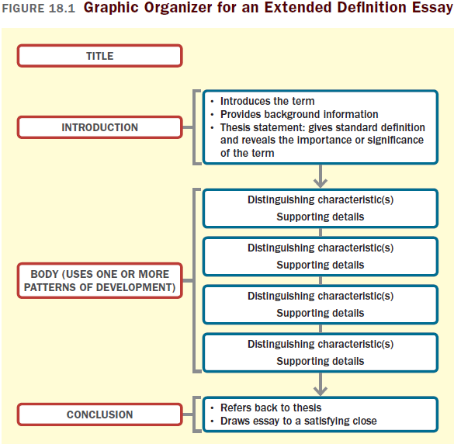

Slide 7
Reading
“Dude, Do You Know What You Just Said?” by Mike Crissey

Slide 8
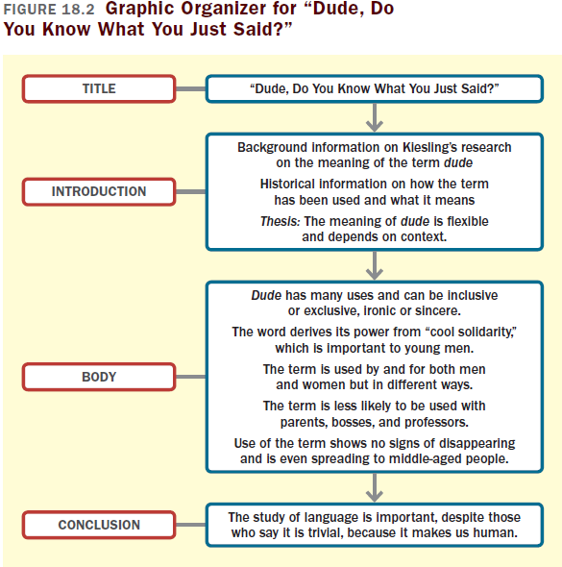

Slide 9
Integrating Definition
into an Essay
The following kinds of terms usually require definition:
Judgmental or controversial terms
Technical terms
Abstract terms

Slide 10
Reading Actively and
Thinking Critically
What to Look For, Highlight, and Annotate
Preview.
Understand the definition.
Identify the strategies the writer uses to explain the term.
Think about the meaning.
Consider your reactions.
(continued)

Slide 11
Analyzing Extended Definitions
Are the definitions expressed in objective language?
Are the definitions evasive?
Is the term defined completely?

Slide 12
A Guided Writing Assignment
Your Essay Assignment
Prewriting
Select a topic.
Narrow your topic to a more specific term.
Consider your purpose, audience, and point of view.
Identify distinguishing characteristics and supporting details.
Generate supporting details.
(continued)

Slide 13
A Guided Writing Assignment
Organizing and Drafting
Draft your thesis statement.
Choose a method of organization.
Draft your extended definition essay.
Revising
Evaluate your draft and revise as necessary.
Editing and Proofreading
Edit and proofread your essay.

Slide 14
