Slide 1
chapter 19
Cause and Effect: Using Reasons and Results to Explain

Slide 2
Contents of Chapter 19
Characteristics of Cause-and-Effect Essays
Reading: “Why Summer Makes Us Lazy,” by Maria Konnikova
Visualizing Cause-and-Effect Essays: Three Graphic Organizers
Reading: “How Labels Like Black and Working Class Shape Your Identity,” by Adam Alter
Integrating Cause and Effect into an Essay
Reading Actively and Thinking Critically
What to Look For, Highlight, and Annotate
Analyzing Cause and Effect

Slide 3
Contents for Chapter 19
A Guided Writing Assignment
Readings: Cause and Effect in Action
Student Essay: “Is Sharing Files Online Killing Music?” by Jonathan Adamczak
Cause and Effect Essay: “Can Diet Help Stop Depression and Violence?” by Jurriaan Kamp
Cause and Effect Combined with Other Patterns: “Dining in the Dark,” by Charles Spence and Betina Piqueras-Fiszman
Applying Your Skills: Additional Essay Assignments

Slide 4
What Are Causes and Effects?
A cause-and-effect essay, also called a causal analysis, analyzes:
Causes (why an event or phenomenon happens),
Effects (what happens because of the event or phenomenon), or
Both causes and effects

Slide 5
Characteristics of
Cause-and-Effect Essays
Causal Analysis
may focus on causes, effects, or both.
includes a clear thesis statement.
is logically organized.
explains each cause or effect fully.
may challenge readers’ assumptions or offer surprising reasons.
Reading
“Why Summer Makes Us Lazy,” Maria Konnikova

Slide 6
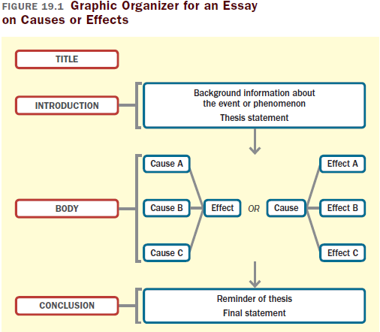

Slide 7
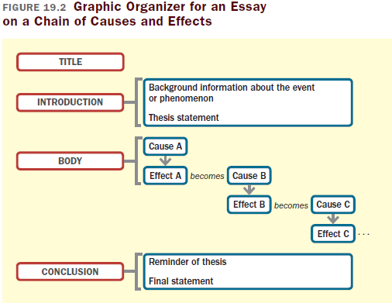

Slide 8
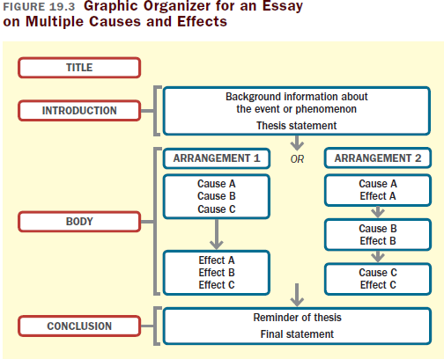

Slide 9
Reading
“How Labels Like Black and Working Class Shape Your Identity,” by Adam Alter

Slide 10
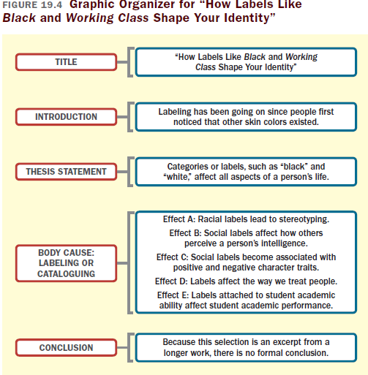

Slide 11
Integrating Cause and Effect
into an Essay
Introduce the causal analysis.
Keep the causal explanation direct and simple.
Use causal analysis to emphasize why particular points or ideas are important.

Slide 12
Reading Actively and
Thinking Critically
What to Look For, Highlight, and Annotate
Preview.
Identify the causal relationship.
Establish the sequence of events.
Think about the meaning.
Consider your reactions.
(continued)

Slide 13
Analyzing Cause and Effect
What is the writer’s purpose?
Does the writer cover all major causes or effects fairly?
Does the writer provide sufficient evidence for the causal relationship?
Does the writer avoid common reasoning errors?

Slide 14
A Guided Writing Assignment
Your Essay Assignment
Prewriting
Select a topic.
Consider your purpose, audience, and point of view.
Discover causes and effects.
Identify primary causes and effects.
Gather evidence to support your thesis.
(continued)

Slide 15
A Guided Writing Assignment
Organizing and Drafting
Draft your thesis statement.
Choose a method of organization.
Draft your cause-and-effect essay.
Revising
Evaluate your draft and revise as necessary.
Editing and Proofreading
Edit and proofread your essay.

Slide 16
