Slide 1
chapter 2
Writing in College

Slide 2
Academic Writing: What to Expect
Expect your writing to become less personal.
Expect to write in different forms, or genres.
Expect to use the language of the discipline.
Expect to use standard American English.
Expect to read, write, and think critically.
Expect to use and document scholarly sources.
Expect to write multiple drafts.

Slide 3
Why Improve Your Writing Skills?
Writing helps you learn and remember.
Writing helps you think and solve problems.
Writing skills help you succeed in college and career.

Slide 4
Developing Strategies for Writing
Start with a positive attitude.
Use your course syllabus.
Use the right writing tools.
Use the college writing center.
Keep a writing journal.
Get the most out of writing conferences.

Slide 5
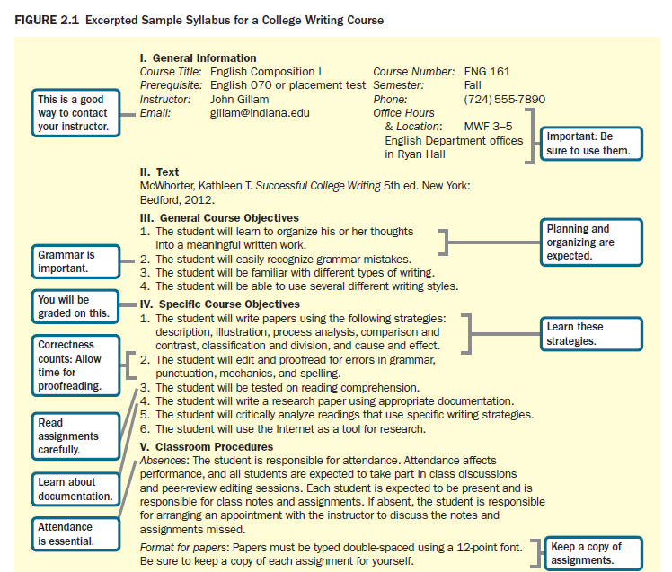
(continued)

Slide 6
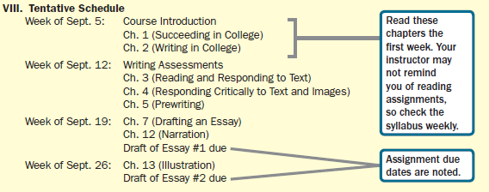
Fig. 2.1
(cont.)

Slide 7
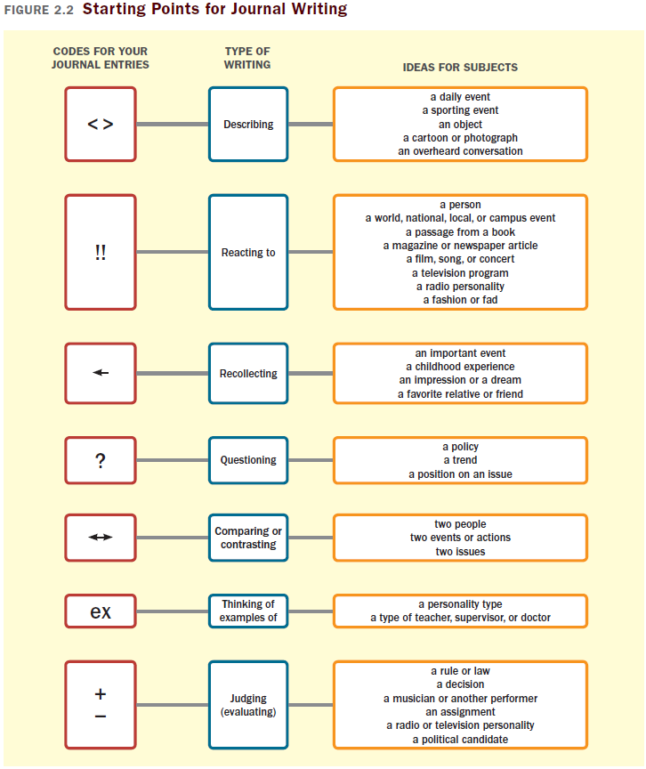

Slide 8
What Is Your Learning Style?
Learning Style Inventory
Interpreting your scores
Applying your learning style to your writing
How to use your findings

Slide 9
Applying Your Learning Style to Your Writing
Your learning style profile indicates your strengths as a writer.
Experiment with options.
Don’t expect the option that is consistent with your learning style to require less attention or effort.
Keep logs of the skills and approaches that work for you and the ones you need to work on.

Slide 10
