Slide 1
chapter 20
Reading Arguments

Slide 2
Contents of Chapter 20
The Basic Parts of an Argument
Reading: “Organ Donation: A Life-Saving Gift,” by Quinne Sember
Reading: “Tipping Is an Abomination,” by Brian Palmer
Reading Actively and Thinking Critically
Before You Read
While You Read
Analyzing the Basic Components of an Argument
Identifying Emotional Appeals
Evaluating Opposing Viewpoints
Detecting Faulty Reasoning
(continued)

Slide 3
Contents for Chapter 20
Readings: Argument in Action
Reading: “How (and Why) to Stop Multitasking,” by Peter Bregman
Reading: “In Defense of Multitasking,” by David Silverman

Slide 4
What Is an Argument?
A sound argument makes a claim and offers reasons and evidence in support of that claim, while anticipating, acknowledging, and responding to opposing viewpoints.

Slide 5
The Basic Parts of an
Argument
The Issue
A controversy, problem, or idea about which people hold different points of view.
The Claim
Claims of fact
Claims of value
Claims of policy
(continued)

Slide 6
The Basic Parts of an
Argument
The Support
Reasons (general statement that supports a claim)
Evidence (Facts, statistics, examples, expert opinion, personal experience)
Emotional Appeal
Appealing to needs
Appealing to values
Refutation
A rebuttal that acknowledges an opposing view and argues against it.

Slide 7
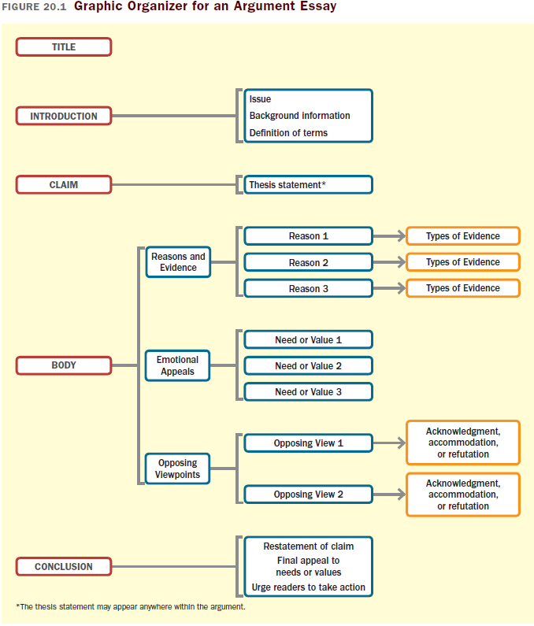

Slide 8
Readings
“Organ Donation: A Life-Saving Gift,” by Quinne Sember
“Tipping Is an Abomination,” by Brian Palmer

Slide 9
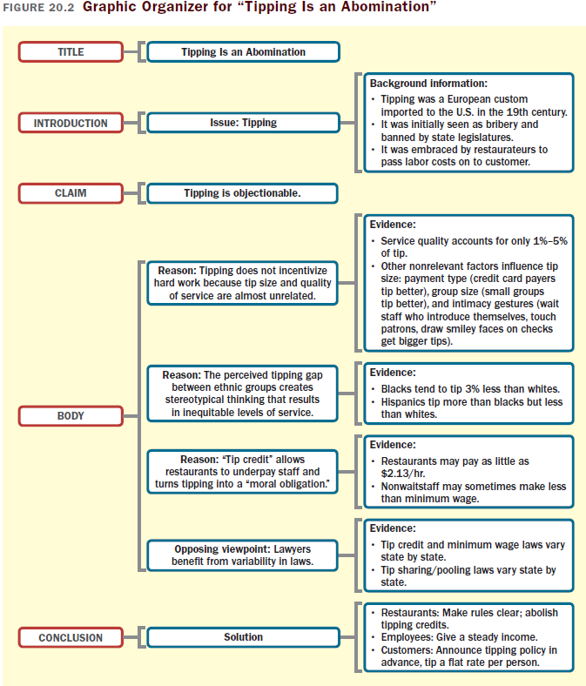

Slide 10
Reading Actively and
Thinking Critically
Before You Read
Think about the title.
Check the author’s name and credentials.
Look for the original source of publication, its slant, and its intended audience.
Check the publication date.
Preview the essay.
Think about the issue before you read.
(continued)

Slide 11
While You Read
Read first for an initial impression.
Read a second time with a pen in hand.
Check your comprehension by summarizing or drawing a graphic organizer
(continued)

Slide 12
Analyzing the Basic Components of an Argument
The writer’s purpose
The intended audience
The writer’s credibility
Support: reasons and evidence
Definitions of key terms
(continued)

Slide 13
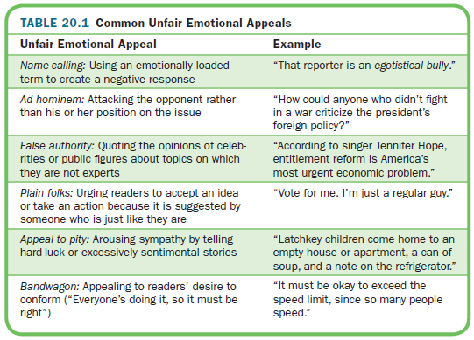
Identifying Emotional Appeals
(continued)

Slide 14
Evaluating Opposing Viewpoints
Does the author state the opposing viewpoint clearly?
Does the author present the opposing viewpoint fairly and completely?
Does the author clearly show why he or she considers the opposing viewpoint wrong or inappropriate?
Does the author acknowledge or accommodate points that cannot be refuted?
(continued)

Slide 15
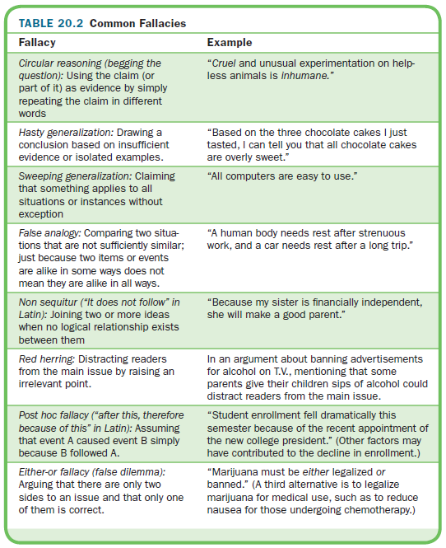
Detecting Faulty Reasoning

