Slide 1
chapter 21
Writing Arguments

Slide 2
Contents of Chapter 21
Characteristics of Argument Essays
Reading: “Second Chances, Social Forgiveness, and the Internet,” by Amitai Etzioni and Radhika Bhat
Visualizing an Argument Essay: A Graphic Organizer
Reading: “Abolish the Penny,” by William Safire
Guided Writing Assignment
(continued)

Slide 3
Contents for Chapter 21
Readings: Argument in Action
Student Essay: “Pull the Plug on Explicit Lyrics,” by James Sturm
Applying Your Skills: Additional Essay Assignments

Slide 4
Characteristics of
Argument Essays
An argument
focuses on arguable, narrowly defined issues.
states a specific claim in a thesis and may call for action.
follows a logical line of reasoning.
inductive reasoning
deductive reasoning
(continued)

Slide 5
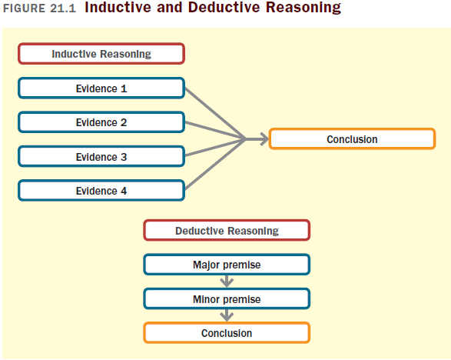

Slide 6
An argument (cont.)
depends on careful audience analysis.
agreeing audiences
neutral or wavering audiences
disagreeing audiences
presents reasons supported by convincing evidence.
appeals to readers’ needs and values.
recognizes opposing views.

Slide 7
Reading
“Second Chances, Social Forgiveness, and the Internet,” by Amitai Etzioni and Rhadhika Bhat

Slide 8
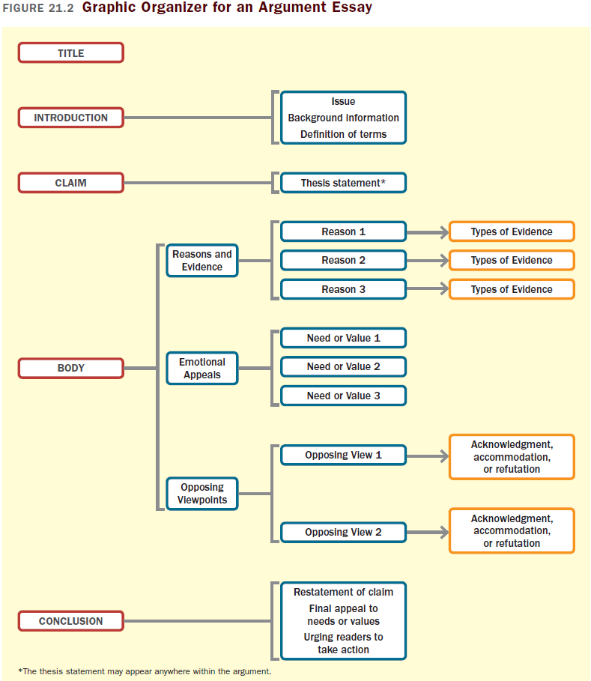

Slide 9
Reading
“Abolish the Penny,” by William Safire

Slide 10
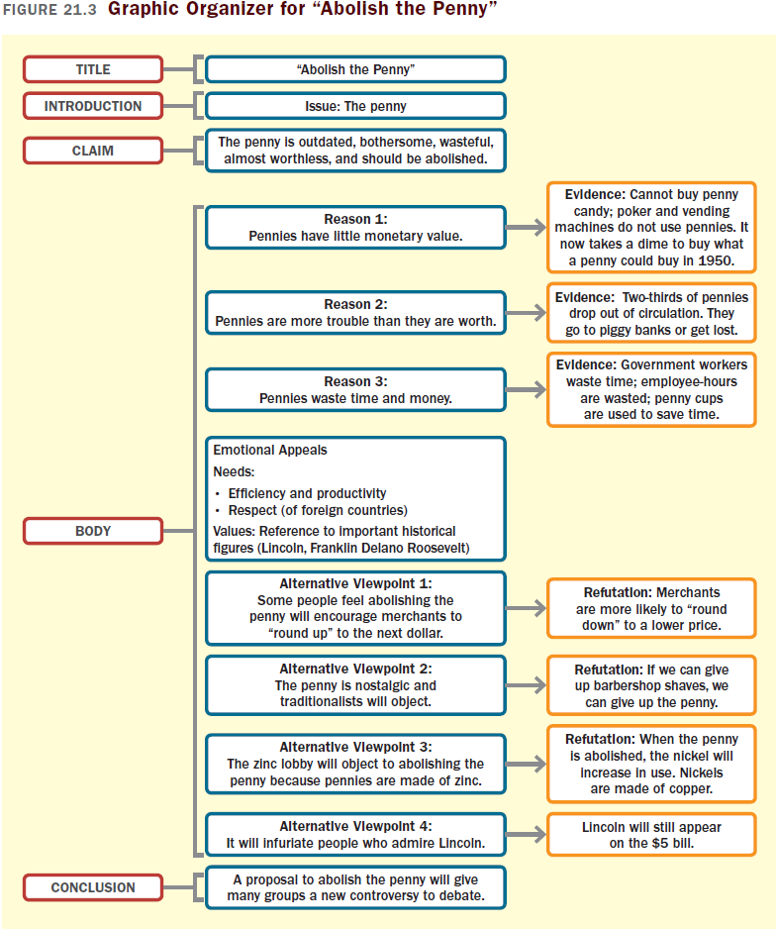

Slide 11
A Guided Writing Assignment
Your Essay Assignment
Prewriting
Choose and narrow a controversial issue.
Consider your purpose, audience, and point of view.
Explore your issue.
Research your issue.
Consider alternative viewpoints.
(continued)

Slide 12
A Guided Writing Assignment
Organizing and Drafting
Draft your thesis statement.
Choose a line of reasoning and a method of organization.
Draft your argument essay.
Revising
Evaluate your draft and revise as necessary.
Editing and Proofreading
Edit and proofread your essay.

Slide 13
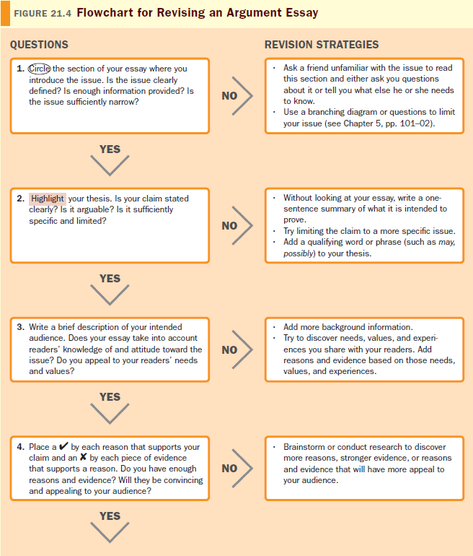
(continued)

Slide 14
