Slide 1
chapter 22
Planning a Research Project and
Evaluating Sources

Slide 2
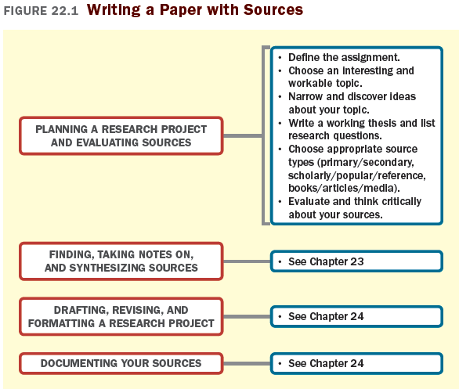

Slide 3
Writing from Sources: Using Sources to
Make Your Own Ideas More Convincing
Use information from sources to
Make general comments more specific.
Provide specific examples to illustrate your main points.
Use sources to supply technical information.
Support opinions with concrete evidence.
Provide historical information or context.
Compare information about similar events or ideas with those you are discussing.
(continued)

Slide 4
Synthesis allows you to
Explore different points of view.
Review key ideas on a topic.
Understand your topic in depth.

Slide 5
Planning Your Research Project
Define the Assignment
Choose an Interesting and Workable Topic
Narrow and Discover Ideas about Your Topic
Do some preliminary reading.
Try prewriting.
Write a Working Thesis and List Research Questions

Slide 6
Considering Source Types
Primary and Secondary Sources
Primary sources are firsthand sources.
Examples: historical documents, literary works, autobiographies, research reports, eyewitness accounts, interviews, observations, and correspondence.
Secondary sources report or comment on primary sources.
Examples: researched books and articles
(continued)

Slide 7
Scholarly, Popular, and Reference Sources
Scholarly sources are written by professional academics and researches.
Include books by university presses and professional publishing companies.
Most are peer reviewed.
Reference works are collections of facts, data, and information.
Examples: encyclopedias, dictionaries
Popular sources discuss the “real world.”
Examples: newspapers, magazines, general-interest books.
(continued)

Slide 8
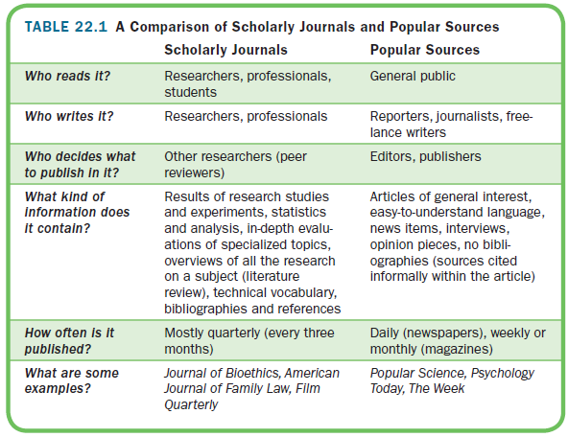

Slide 9
Books, Articles, and Media Sources
Books are often the products of years of study and are typically more in-depth.
Usually written by authorities on the subject.
Articles are briefer than books and may be more up-to-date.
Tend to be more focused, exploring 1-2 points.
Include an abstract.
Media sources can help illustrate a text.
Examples: photographs, information graphics, podcasts, works of fine art
(continued)

Slide 10
Evaluating Sources
Choosing Relevant Sources
Is the source appropriate for your audience?
Is the source up-to-date?
(continued)

Slide 11
Choosing Reliable Sources
Is the source scholarly?
Does the source have a solid reputation?
What is the publication’s purpose?
Is the source professionally edited and presented?
Is the author an expert in the field?
Does the author approach the topic fairly and objectively?
Can the content be verified?
(continued)

Slide 12
Evaluating Resources in the Digital Landscape
Consider
Where you accessed the source: if through your college library, it’s most likely reliable.
If the source is an electronic version of a respected print publication.
If the source doesn’t specify authorship, be cautious.
The source may not be credible if it has
errors
poor design
too many photos
strong language
(continued)

Slide 13
Thinking Critically About Sources
Analyze the author’s
Ideas
Language
Assumptions, generalizations, and omissions.
(continued)

Slide 14
