Slide 1
chapter 23
Finding Sources,
Taking Notes,
and Synthesizing

Slide 2
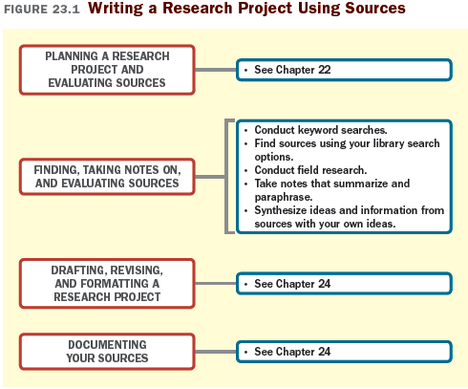

Slide 3
An Overview of Library
Sources
Learn Your Way around the Library
Take a formal tour of the library.
Take your own tour.
Tour the library’s Web site.

Slide 4
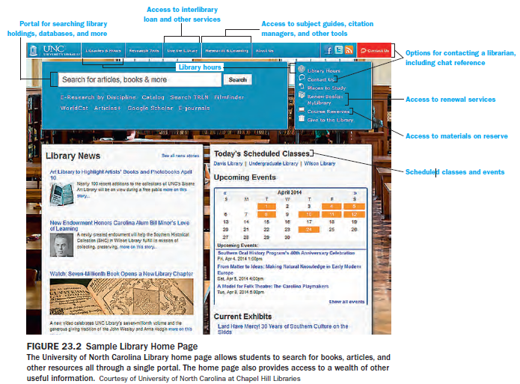

Slide 5
Make Use of Reference Librarians
Librarians can help you
refine your topic
show you reference resources or basic books that can get you started
identify other collections that might help you
help you decide on search terms
obtain full text of articles
show you how to use citation systems.

Slide 6
Using Keywords Effectively
Tips to improve search results
Use more specific terms for better results.
Include synonyms.
Use full names and titles.
Use the advanced search functions.
Use subject headings.
Combine keywords to make a more specific search.
Use subject terms to find related readings.

Slide 7
Using Appropriate Search Tools
For books and other library holdings:
use your library’s catalog
For articles, use your library’s databases
For useful Web sites, use the internet search engines.
news sites
general reference sites
government documents
For shared information from a community interested in a particular topic, use listservs and newsgroups.

Slide 8
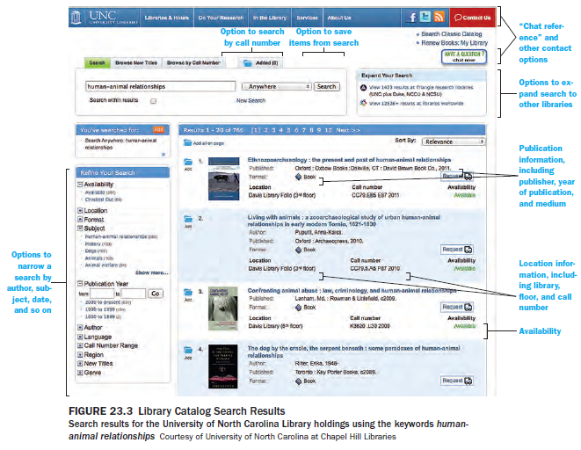

Slide 9
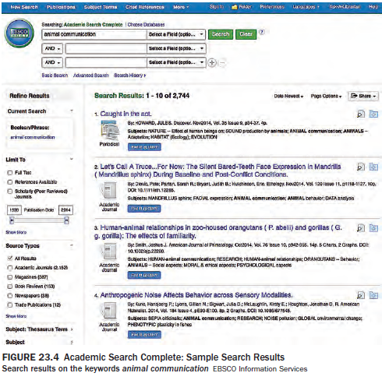

Slide 10
Conducting Field Research
Interviewing
Using a Survey
Conducting Observations

Slide 11
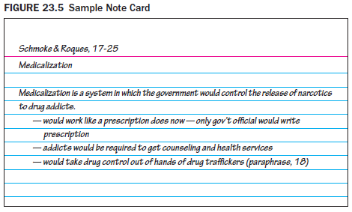
Working with Sources: Taking Notes, Annotating, and Paraphrasing
Take notes
use note-taking tools (computer folders, notebooks, software programs)
annotate and highlight source materials
(continued)

Slide 12
Take notes that summarize, paraphrase, or quote
Summarizing
Record only relevant information.
Condense the author’s ideas into your own words
Record the ideas in order.
Reread your summary to be sure it’s adequate.
Record the source publication information.
Paraphrasing
Read first, then write.
Use synonyms.
Use your own sentence structure.
Rearrange the ideas if possible.
Quoting
Enclose quotations with quotation marks.
Record source information.
(continued)

Slide 13
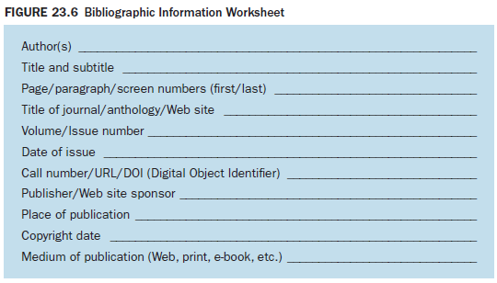
Keep track of sources

Slide 14
Working with Sources: Evaluating
Your Notes and Synthesizing
Evaluate Your Research
1. What research questions did I begin with?
2. What answers did I find to those questions?
3. What other information did I discover about my topic?
4. What conclusions can I draw from what I’ve learned?
5. How does my research affect my working thesis?
Use Categories to Synthesize Information from Sources
Draw a Graphic Organizer to Synthesize Sources

Slide 15
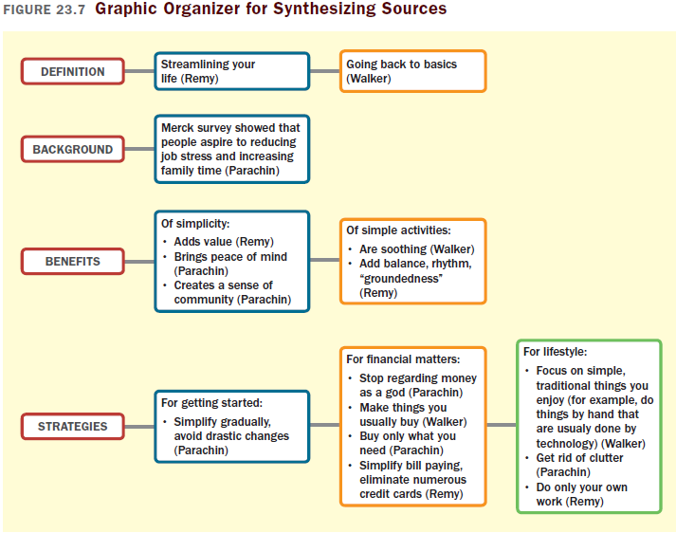

Slide 16
Create an Annotated Bibliography
Annotated Bibliography
A list of sources that includes both publication information and a brief summary of each source

