Slide 1
chapter 26
Essay Examinations and Portfolios

Slide 2
Essay Examinations
Preparing for Essay Exams
Write study sheets that synthesize information.
Predict essay exam questions.
Draft answers in outline form.
Reduce informal outlines to key-word outlines.

Slide 3
Taking Essay Exams
Follow General Guidelines
Analyze Essay Exam Questions
Writing Essay Answers
Write your thesis statement.
Develop supporting details.
Reread and proofread your answer.

Slide 4
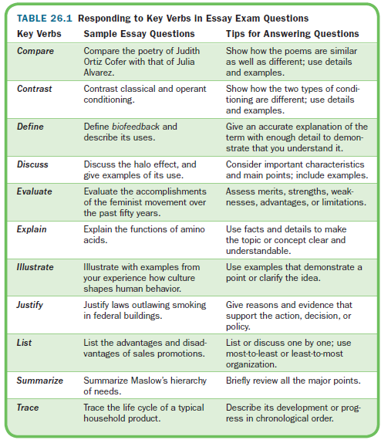

Slide 5
Portfolios
Creating a Writing Portfolio
Purposes of a Writing Portfolio
Deciding What to Include
Using Your Course Syllabus as a Guide
Organizing and Preparing to Present Your Portfolio
What to Avoid

Slide 6
