Slide 1
chapter 5
Prewriting: How to Find and Focus Ideas

Slide 2
Choosing a Topic
Look for topics that
are appropriate for the assignment
you know something about
you want to learn more about
will maintain your interest

Slide 3
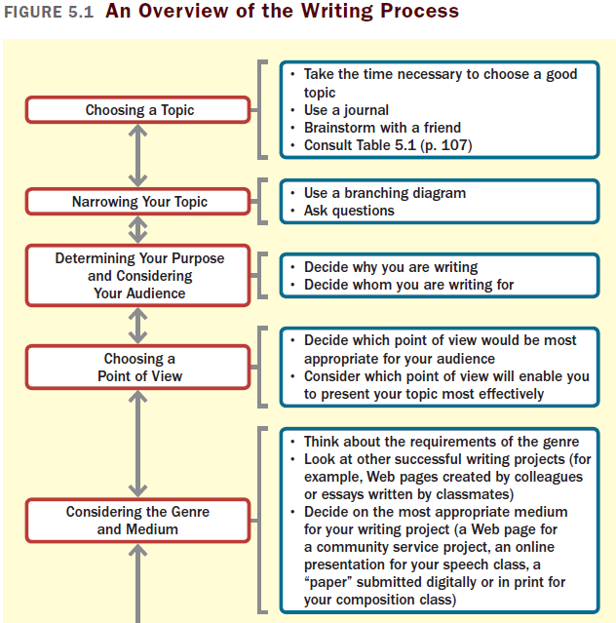
(continued)

Slide 4
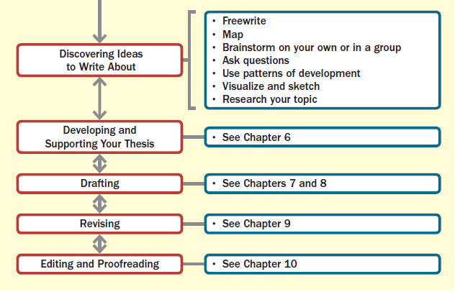
An Overview of the Writing Process (cont.)

Slide 5
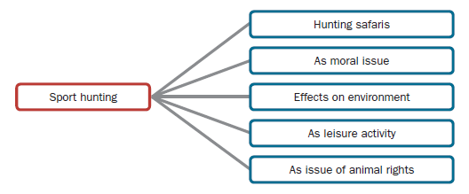
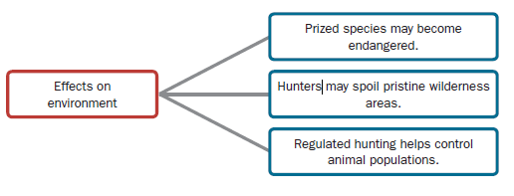
Narrowing a Topic
Use a Branching Diagram

Slide 6
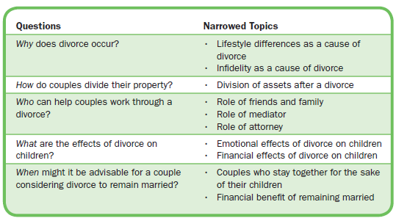
Ask Questions to Narrow a Broad Topic
Ask questions—who, what, where, when, why, and how—to narrow your attention to specific aspects within the topic.

Slide 7
Thinking About Your Writing Situation
Determining Your Purpose
To express
To inform
To persuade
Why are you writing the essay?
What do you want the essay to accomplish?

Slide 8
Considering Your Audience
How to consider your audience: Your readers
are not present
do not know everything you know
may not share your opinions and values
may not respond to situations and issues like you do
Adjust your tone—how you sound—to fit your audience.
What does your audience know or not know about your topic?
What is the education, background, and experience of your audience?
What attitudes, beliefs, opinions, or biases is your audience likely to hold?
What tone do your readers expect you to take?

Slide 9
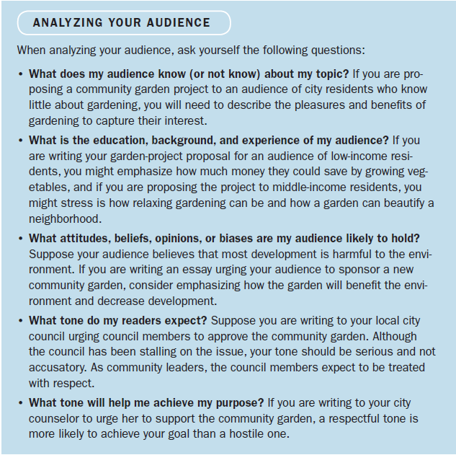

Slide 10
Choosing a Point of View
Consider your topic, purpose, and audience to choose the most appropriate point of view—the perspective from which you write your essay.
First Person: Keep it personal, using the pronouns I, me, mine, we, and ours and writing from your own perspective and experience.
Second Person: Address or appeal to the reader directly, using the pronouns you, your, and yours to instruct, explain, or persuade.
Third Person: Show your objectivity, using the pronouns he, she, and they to report your observations and arguments.

Slide 11
Considering the Genre and Medium
Each genre (type of text) has its own conventions, which you need to understand by reviewing examples of the writing.
Examples: laboratory reports, proposals, blog posts
The medium (means through which ideas are expressed) should suit your purpose and audience.
Examples: print, electronic, Web, videos

Slide 12
Discovering Ideas to Write About
Freewriting
Set a timer for five to ten minutes and write nonstop, recording ideas as they come to you.
Don’t worry about grammar, punctuation, or spelling.

Slide 13
Mapping
Write your topic in the middle of a blank sheet of paper.
Think of related ideas and write them around your topic.
Use lines to indicate related ideas and show how general ideas can branch out into many more specific ideas.
(continued)

Slide 14
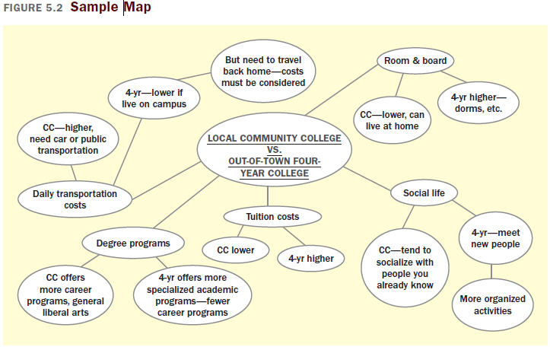

Slide 15
Brainstorming
List everything that comes to mind when you think about your topic.
Impressions
Emotions
Reactions
Facts
Questioning
Write down every question you can think of about your topic.
Start with who, what, where, when, why, and how and then dig deeper with questions like What if…? or So what that…?

Slide 16
Using the Patterns of Development
The 9 patterns of development are:
Narration
Description
Illustration
Process analysis
Comparison and contrast
Classification and division
Definition
Cause and effect
Argument
Think about your topic through the lens of each pattern, using the questions in Table 5.2.

Slide 17
Visualizing or Sketching
Close your eyes and picture the subject in your mind.
Draw a picture – or a series of sketches, called a storyboard – to show events or relationships among ideas.
Researching Your Topic
Do some preliminary searching to see what others have already said about your topic.
Take notes with good citations to avoid plagiarism and help you find the source later.

Slide 18
