Slide 1
chapter 6
Developing and Supporting a Thesis

Slide 2
What Is a Thesis Statement?
Thesis statement: A statement that explains what the essay is about and presents the author’s position on the subject
An effective thesis should
Introduce your topic
Reveal what the essay is about
State the point you will make

Slide 3
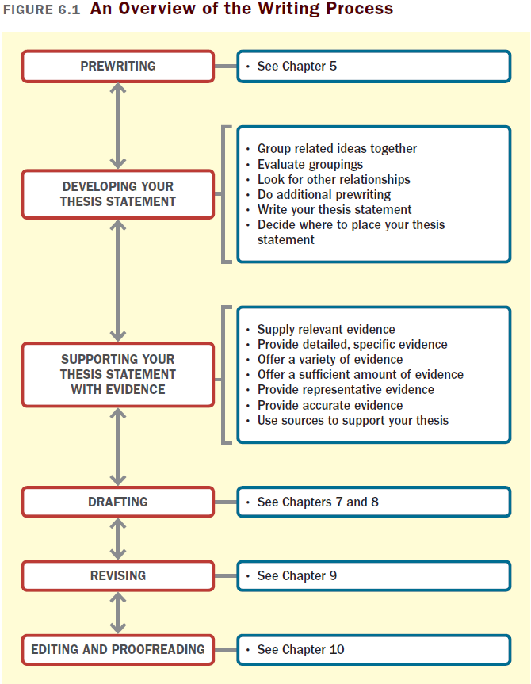

Slide 4
Developing Your Thesis Statement
As you develop your thesis statement, expect to
evolve your thesis during prewriting
do research to revise your thesis
revise your thesis as you draft and revise your essay

Slide 5
Synthesizing Ideas to Generate a Working Thesis Statement
To come up with a working thesis statement,
Reread your prewriting and brainstorming and organize your ideas into several categories.
Choose the strongest, most compelling group or groups and write a word or phrase that describes it/them.
Consider whether you have enough relevant details if your list is thin.

Slide 6
Writing an Effective Thesis Statement
An effective thesis statement should
Make an assertion, take a position, express a viewpoint, or suggest your approach toward the topic
Be specific. Provide as much information as possible about your main point.
Focus on the central point. Limit your essay to one major idea.
Offer an original perspective on your topic. If it’s dull or ordinary, it probably needs more work; search your prewriting and brainstorming for an interesting angle.
(continued)

Slide 7
An effective thesis statement should (cont.)
Avoid making announcements, such as “This essay will discuss” or “The subject of my paper is”. Instead, state your main point directly.
Use your thesis to preview the organization of the essay. Mention the two or three key concepts of your essay in the order in which they will be discussed.

Slide 8
Placing the Thesis Statement
Your thesis can go anywhere in your essay, but it’s usually best to include it in the first paragraph of your introduction, so readers know what to expect for the rest of the essay.
Using an Implied Thesis
Used mostly in narrative or descriptive writing, implied theses are stated indirectly through the details writers choose and the way those details are organized.

Slide 9
Supporting Your Thesis Statement with Evidence
Tailoring the Evidence to Your Writing Situation
Consider your purpose, audience, point of view, genre, and medium to determine which evidence is most effective.
Evidence is any type of information, such as examples, statistics, or expert opinion, that supports your thesis
Is your audience familiar with your topic? If not, offer definitions, historical background, explanations, and factual or descriptive details.
Is your purpose to persuade? If so, use statistics, comparisons and contrasts, and examples to make your argument.

Slide 10
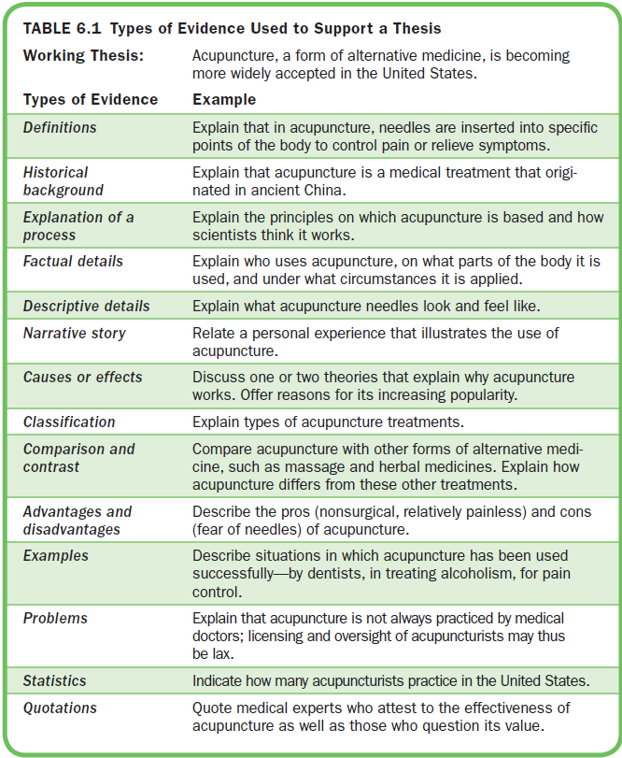

Slide 11
Collecting Evidence to Support Your Thesis
Complete the evidence worksheet (Figure 6.2), collecting only the evidence that is appropriate to your topic
Talk it out. What would you say to convince your audience of your thesis?
List the headings or main points of the essay and write ideas for evidence under each.
Draw a graphic organizer of your essay and fill in supporting evidence as you think of it.
Try to convince a classmate. Why should he or she accept your thesis?

Slide 12
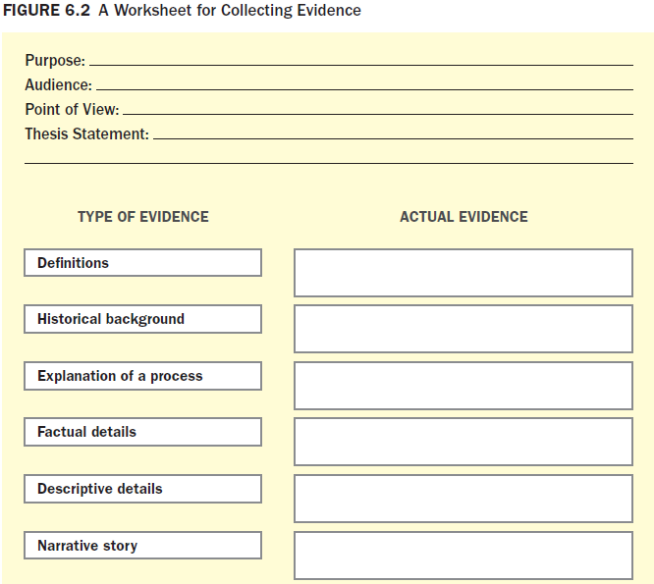
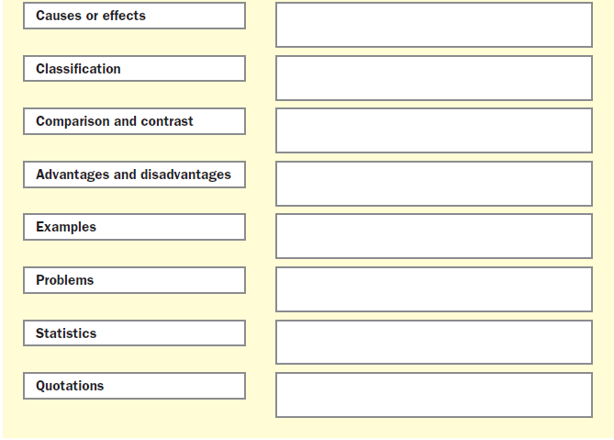

Slide 13
Choosing the Best Evidence
Evidence must
Be relevant
Provide specific evidence
Be varied
Be representative
Be accurate
Be sufficient to persuade readers

Slide 14
Choosing Evidence for Academic Writing
For academic writing, use objective evidence such as facts, statistics, historical background, and expert testimony.
Incorporating Visuals into an Essay
Consider using visuals to complement and enhance your ideas, appeal to your readers, and suit the genre and medium in which you are writing.
Using Sources to Support Your Thesis
Use sources you locate through research or interview an expert to collect supporting evidence.

