Slide 1
Selecting a Tablet Computer for the Clinical Staff at Rawlings Regional Medical Center: A Recommendation Report
Prepared by:
Jeremy Elkins, Director of IT
Eloise Carruthers, Director of Nursing
December 15, 2013
Notes:
The title slide shows the title of the presentation and the name and affiliation of each speaker. You might also want to include the date of the presentation.

Slide 2
Recommendation Report Outline
Introduction
Major Results
2.1 Clinical-staff knowledge and attitudes
2.2 BYOD v. hospital-owned model
2.3 Determining criteria
2.4 Assessing tablets
Conclusions
Recommendation
Notes:
[[annos]] The next slide presents an overview, which outlines the presentation. The arrow identifies the point the speaker is addressing.
At the bottom of each slide in the body of the presentation is a footer with the date, the title of the presentation, and the number of the slide. The slide number gives audience members a way to refer to the slide when they ask questions. [[end]]

Slide 3
1. Introduction: IT expenses for tablet maintenance are rising sharply
Notes:
[[annos]] This slide uses a simple bar graph created in PowerPoint. Don’t try to present a lot of information on a single slide.
The title of this slide uses the numbering system introduced in the previous slide. This cue helps the audience understand the structure of the presentation. Following the colon is an independent clause that presents the claim that will be supported in the slide. [[end]]

Slide 4
1. Introduction (cont’d): We cannot certify our tablets for disinfection
Notes:
[[annos]] If the images in your presentation are your own intellectual property or are clip art that comes with the software, you can legally display them anywhere. If they are not, you need to cite their sources and obtain written permission. You have three choices for placing the source statements: at the bottom of the appropriate slides, in a sources slide that you show at the end of the presentation, or on a paper handout that you distribute at the end of the presentation. [[end]]

Slide 5
1. Introduction (cont’d): We lack a policy for making tablets available
Notes:
[[annos]] For second and subsequent slides within the same section of the presentation, use the “continued” abbreviation shown here. Notice that the speakers use one color for the generic term (“Introduction”) and a different color for the claim. [[end]]

Slide 6
Recommendation Report Outline
Introduction
Major Results
2.1 Clinical-staff knowledge and attitudes
2.2 BYOD v. hospital-owned model
2.3 Determining criteria
2.4 Assessing tablets
Conclusions
Recommendation
Notes:
[[annos]] This slide is identical to Slide 2, except that the arrow has moved. Use this organizing slide to help your audience remember the overall organization of your presentation. Don’t overdo it; if you presented this organizing slide just a few slides ago, don’t use it again until you make the transition to the next major unit in the presentation. [[end]]

Slide 7
2.1 Results: Clinical staff own iPads and Androids
Notes:
[[annos]] A pie chart is a logical choice for representing a small number of components (usually, seven or fewer) that add up to 100 percent.
Note that the speakers use conservative blues for all their graphics on the slide set. You don’t need a rainbow full of colors. You need just enough difference so that the audience can distinguish between the different slices. [[end]]

Slide 8
2.1 Results (cont’d): Clinical staff with tablets consider themselves expert users
“I’m an expert user”
Notes:
[[annos]] Slides work best if the text is brief. The speaker will explain that here are the responses to the statement, “I consider myself an expert user of my tablet.” [[end]]

Slide 9
2.1 Results (cont’d): Most clinical staff with tablets use them clinically

Slide 10
2.1 Results (cont’d): Clinical staff with tablets prefer a hospital-owned model to BYOD

Slide 11
2.2 Results: Hospital-supplied model slightly preferable to BYOD
BYOD
Reduced capital cost for RRMC
Staff know and like their tabs
Hospital-supplied
Reduced data-privacy vulnerability
Reduced IT costs
All staff members have a tab
Reduced liability for RRMC
Notes:
[[annos]] This slide was made using SmartArt graphics, which are part of PowerPoint. SmartArt graphics help you show logical relationships. Here, the relationship is that the hospital-supplied model is “heavier”—that is, has more to recommend it—than the BYOD model.
The speakers added the checkmark to emphasize that the hospital-supplied model is preferable to the BYOD model. [[end]]

Slide 12
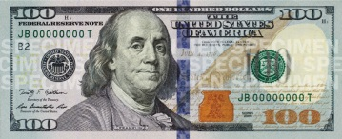
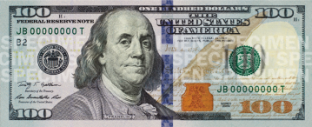
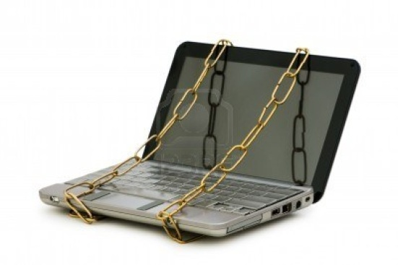
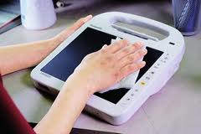
2.3 Results: We set four necessary criteria for tablet study
Notes:
[[annos]] If the images you show are not your own intellectual property, you can legally display them in a college classroom because they are covered by the fair-use provisions of U.S. copyright law. However, if you display them in a business presentation, you would need formal written permission from the copyright holders. See Ch. 2, pp. 00-00, for more information. [[end]]

Slide 13
2.3 Results (cont’d): We set two desirable criteria for tablet study
Notes:
[[annos]] The speakers used the “appear” animation to display first the picture of the tablet and then the picture of the battery. This feature lets the speakers display on the screen only what they are discussing so that the audience is not distracted by other images. [[end]]

Slide 14
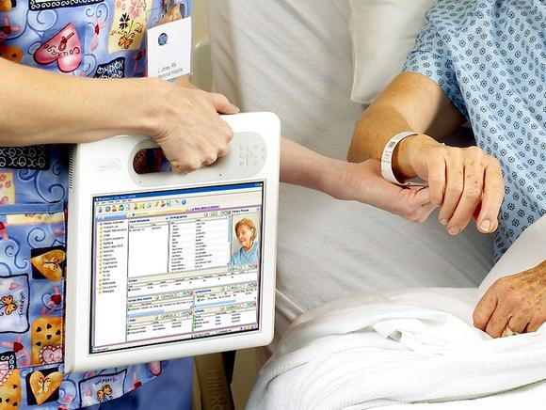
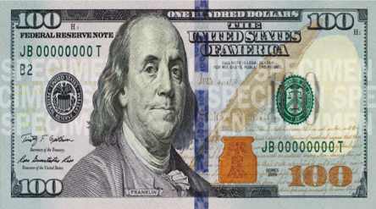
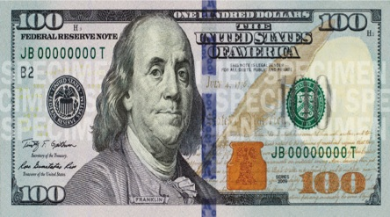
2.4 Results: Medical-grade tablets are too expensive

Slide 15
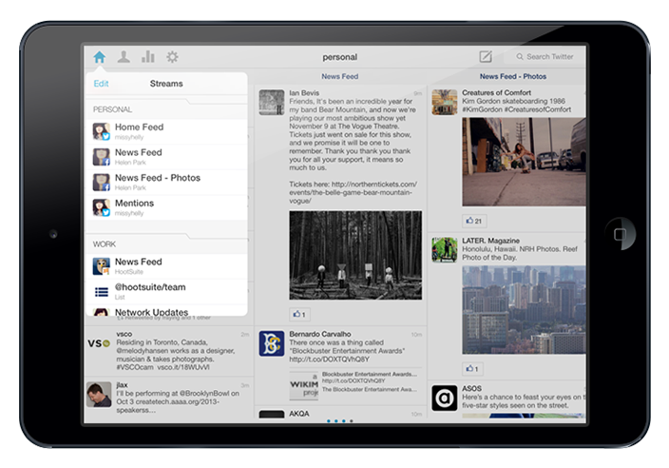
2.4 Results (cont’d): General-purpose tablets meet our data-privacy criterion

Slide 16
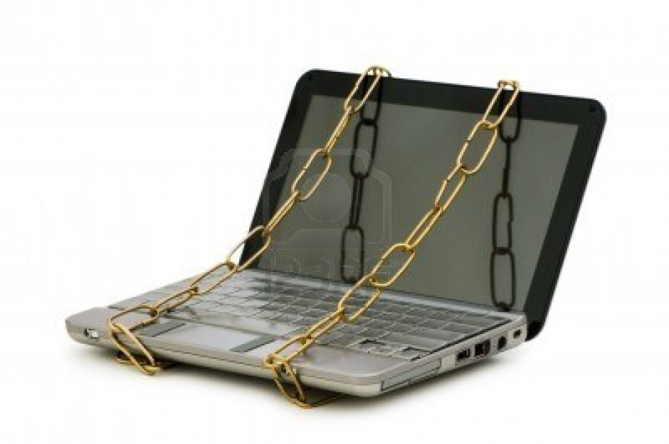
2.4 Results (cont’d): General-purpose tablets meet our other security criteria

Slide 17
2.4 Results (cont’d): General-purpose tablets might meet our disinfection criterion
?
Notes:
[[annos]] The formatting that appears throughout the slide set—the background color, the horizontal rule, and the footer—is created in the Slide-Master view. This formatting appears in every slide unless you modify or delete it for that slide.
Note that the speakers use color—sparingly—for emphasis. [[end]]

Slide 18
2.4 Results (cont’d): General-purpose tablets might meet our durability criterion
?

Slide 19
2.4 Results (cont’d): General-purpose tablets might meet our battery criterion
?

Slide 20
Recommendation Report Outline
Introduction
Major Results
2.1 Clinical-staff knowledge and attitudes
2.2 BYOD v. hospital-owned model
2.3 Determining criteria
2.4 Assessing tablets
Conclusions
Recommendation

Slide 21
3. Conclusions: Clinical staff who own tablets want to use tablets at work
YES
Notes:
[[annos]] As discussed in Ch. 18, conclusions are inferences you draw from results. [[end]]

Slide 22
3. Conclusions (cont’d): The hospital-supplied model is preferable to BYOD
BYOD
Hospital-supplied

Slide 23
3. Conclusions Medical-grade tablets would work; general-purpose ones might
?

Slide 24
Recommendation Report Outline
Introduction
Major Results
2.1 Clinical-staff knowledge and attitudes
2.2 BYOD v. hospital-owned model
2.3 Determining criteria
2.4 Assessing tablets
Conclusions
Recommendation

Slide 25
4. Recommendation: We recommend one of two options
Reconsider budget, study medical-grade tablets.
Test general-purpose tablets on-site.
Notes:
[[annos]] As discussed in Ch. 19, recommendations are statements about what you think should be done next.
Some speakers like to make a final slide with the word “Questions?” on it to signal the end of the presentation. You can also display contact information (such as your e-mail address) to encourage audience members to get in touch with you. [[end]]

